Slide 1
Statistics and R short course
Session 1: Introduction to R Evaristar Kudowa, Marc Henrion

Slide 2
Introduction

Slide 3
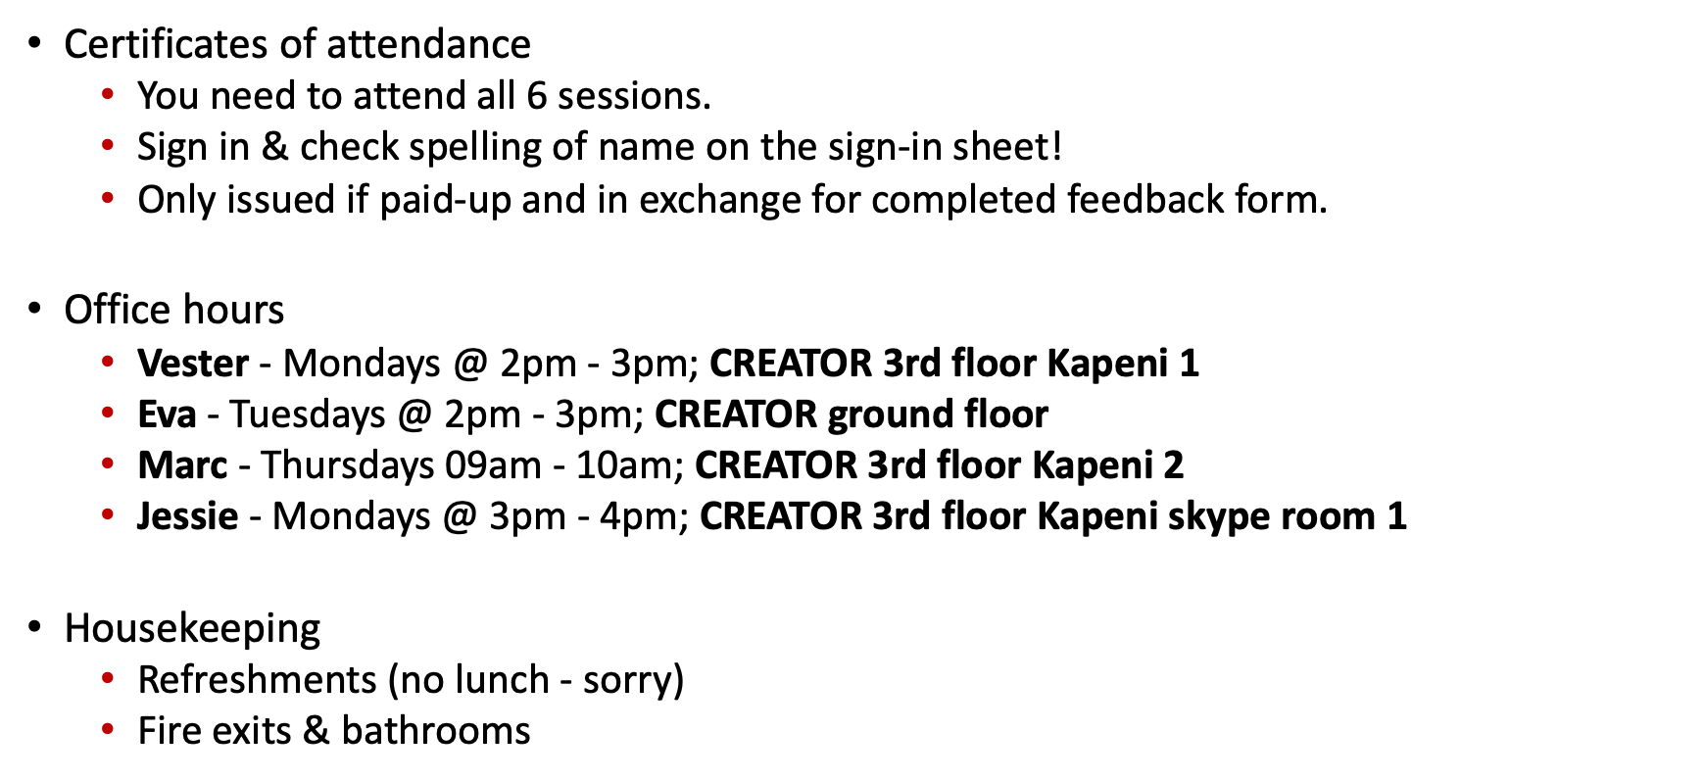
Preliminaries
Certificates of attendance
You need to attend all 6 sessions.
Sign in & check spelling of name on the sign-in sheet!
Only issued if paid-up and in exchange for completed feedback form.
Office hours
Vester - Mondays @ 2pm - 3pm; CREATOR 3rd floor Kapeni 1
Eva - Tuesdays @ 2pm - 3pm; CREATOR ground floor
Marc - Thursdays 09am - 10am; CREATOR 3rd floor Kapeni 2
Jessie - Mondays @ 3pm - 4pm; CREATOR 3rd floor Kapeni skype room 1
Housekeeping
Refreshments (no lunch - sorry)
Fire exits & bathrooms

Slide 4

Course website / GitHub:
GitHub repo with course materials: https://github.com/mlw-stats/R_And_Statistics_Training_2026

Slide 5
Learning outcomes
KNOW R: Explain know what R is & what it can do.
KNOW R RESOURCES: List useful R resources and access them.
DO R: Perform basic operations relevant for your research in R:
Read data into R & write data or results to the hard drive.
Manipulate & use different object types.
Write & use functions in R
Perform basic analyses on a dataset: mean, standard deviation, linear regression.
Produce various standard graphs and tables
UNDERSTAND BASICS OF STATISTICS: Explain basic statistical theory: common distributions, standard statistical techniques, common study designs, assumptions behind common statistical tests and regression models.
UNDERSTAND STUDY DESIGNS: Recommend appropriate designs & analyses.
COMPREHEND OPEN SCIENCE: Summarise principles of open, reproducible research.
DO OPEN SCIENCE WITH R: Use R scripts, R markdown, packages & GitHub.

Slide 6
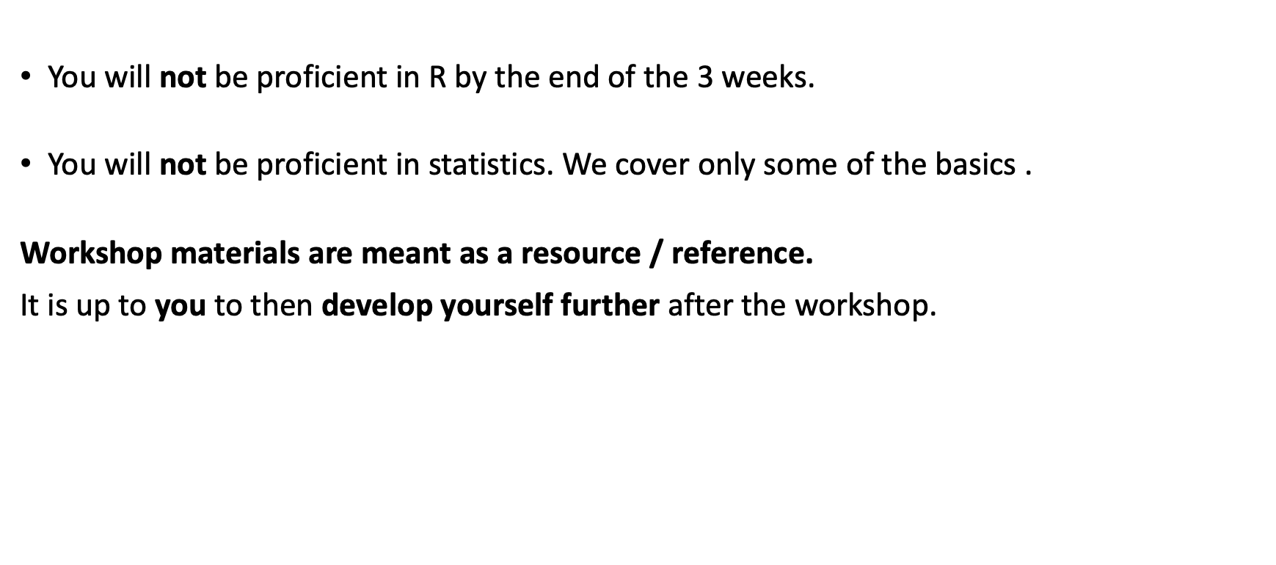
What you will not achieve in this workshop
You will not be proficient in R by the end of the 3 weeks.
You will not be proficient in statistics. We cover only some of the basics .
Workshop materials are meant as a resource / reference.
It is up to you to then develop yourself further after the workshop.

Slide 7
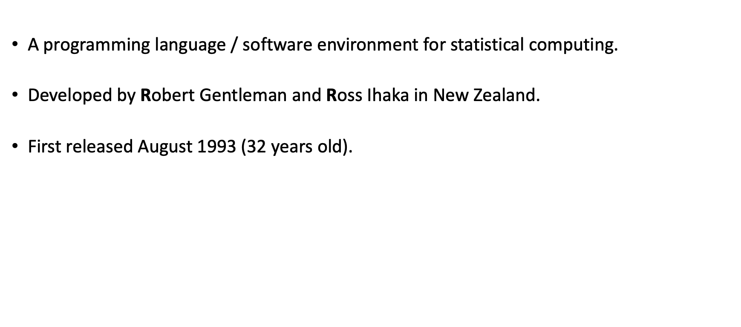
What is R?
A programming language / software environment for statistical computing.
Developed by Robert Gentleman and Ross Ihaka in New Zealand.
First released August 1993 (32 years old).

Slide 8

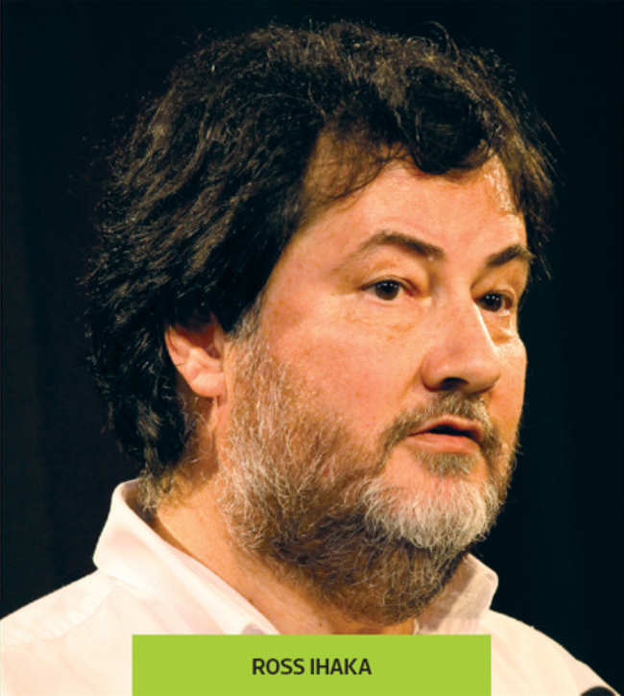
What is R?
Thieme, N., R Generation, Significance, 15 (4), 2018
Thieme, N., R Generation, Significance, 15 (4), 2018

Slide 9
What is R?
Free, open source software
User could submit bug reports; frequent reporters were given permission to edit R itself
This became the R Core Team: Gentleman, Ihaka, Mächler, Dalgaard, Hornik, Leisch, Lumley, …
The Comprehensive R Archive Network (CRAN) was created to make all essential documentation and files available in one place
Kurt Hornik and Friedrich Leisch (Vienna University)
CRAN: allows users to publish custom packages – much of R’s success and functionality derives from this feature
New generation of developers more interested in what R can do and less how it does it
E.g. Hadley Wickham of RStudio / Posit

Slide 10

What is R?
Thieme, N., R Generation, Significance, 15 (4), 2018

Slide 11
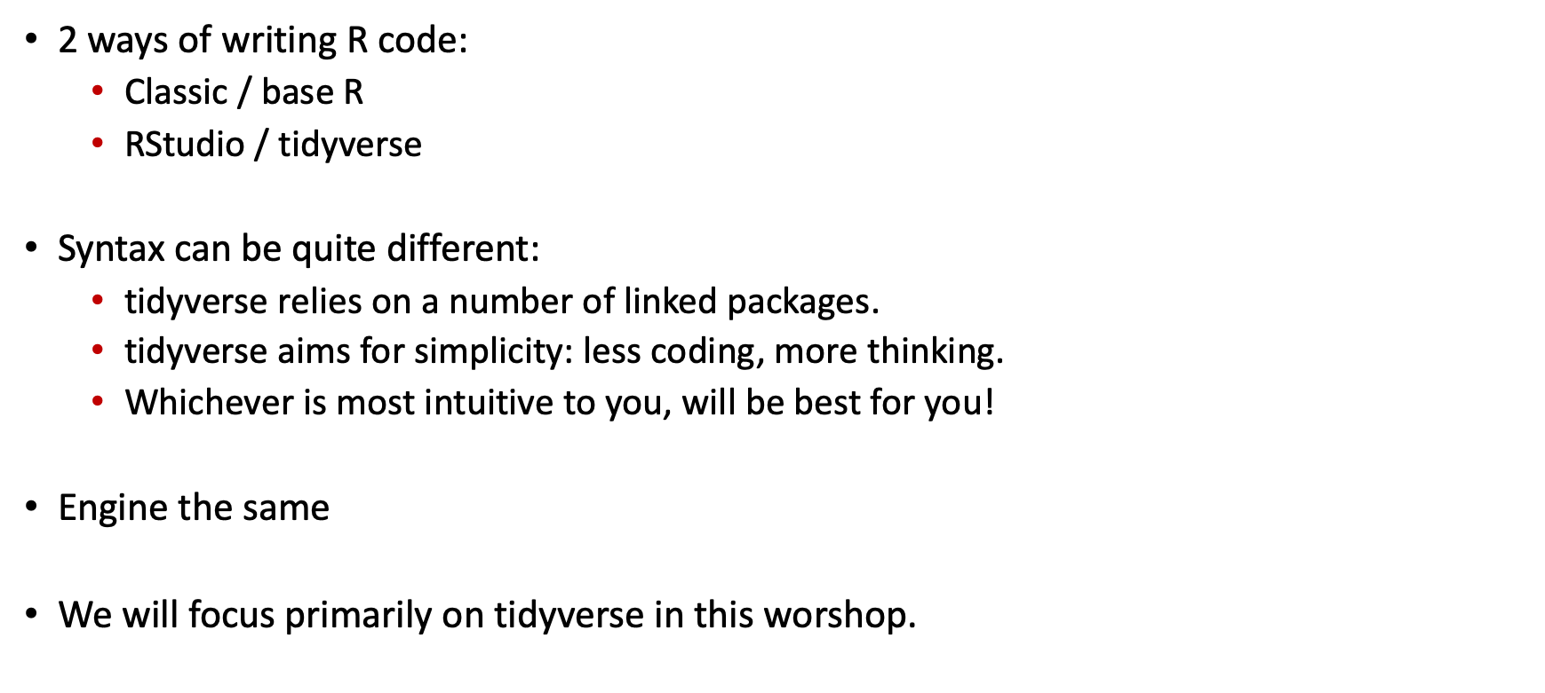
What is R?
2 ways of writing R code:
Classic / base R
RStudio / tidyverse
Syntax can be quite different:
tidyverse relies on a number of linked packages.
tidyverse aims for simplicity: less coding, more thinking.
Whichever is most intuitive to you, will be best for you!
Engine the same
We will focus primarily on tidyverse in this worshop.

Slide 12

Getting started
R and RStudio IDE

Slide 13
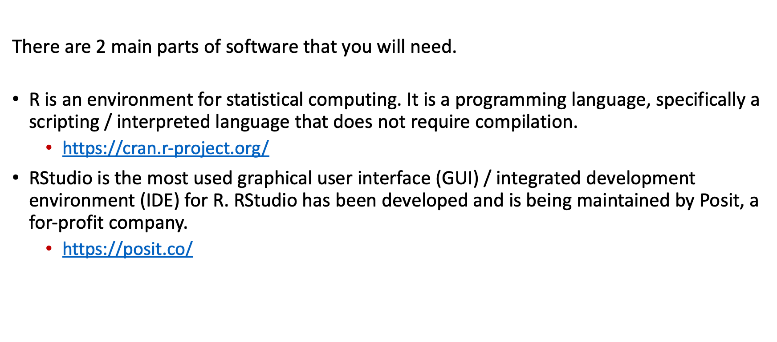
Getting started - R and RStudio IDE
There are 2 main parts of software that you will need.
R is an environment for statistical computing. It is a programming language, specifically a scripting / interpreted language that does not require compilation.
https://cran.r-project.org/
RStudio is the most used graphical user interface (GUI) / integrated development environment (IDE) for R. RStudio has been developed and is being maintained by Posit, a for-profit company.
https://posit.co/

Slide 14
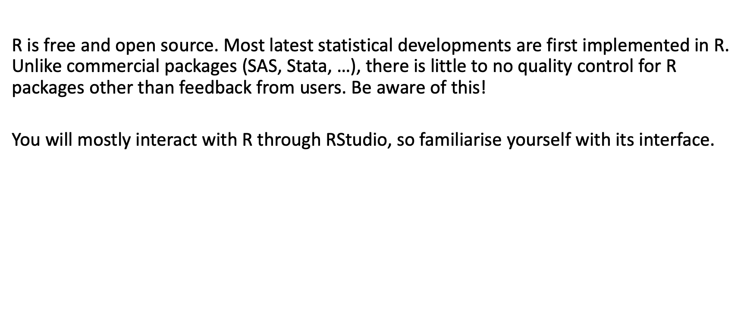
Getting started - R and RStudio IDE
R is free and open source. Most latest statistical developments are first implemented in R. Unlike commercial packages (SAS, Stata, …), there is little to no quality control for R packages other than feedback from users. Be aware of this!
You will mostly interact with R through RStudio, so familiarise yourself with its interface.

Slide 15
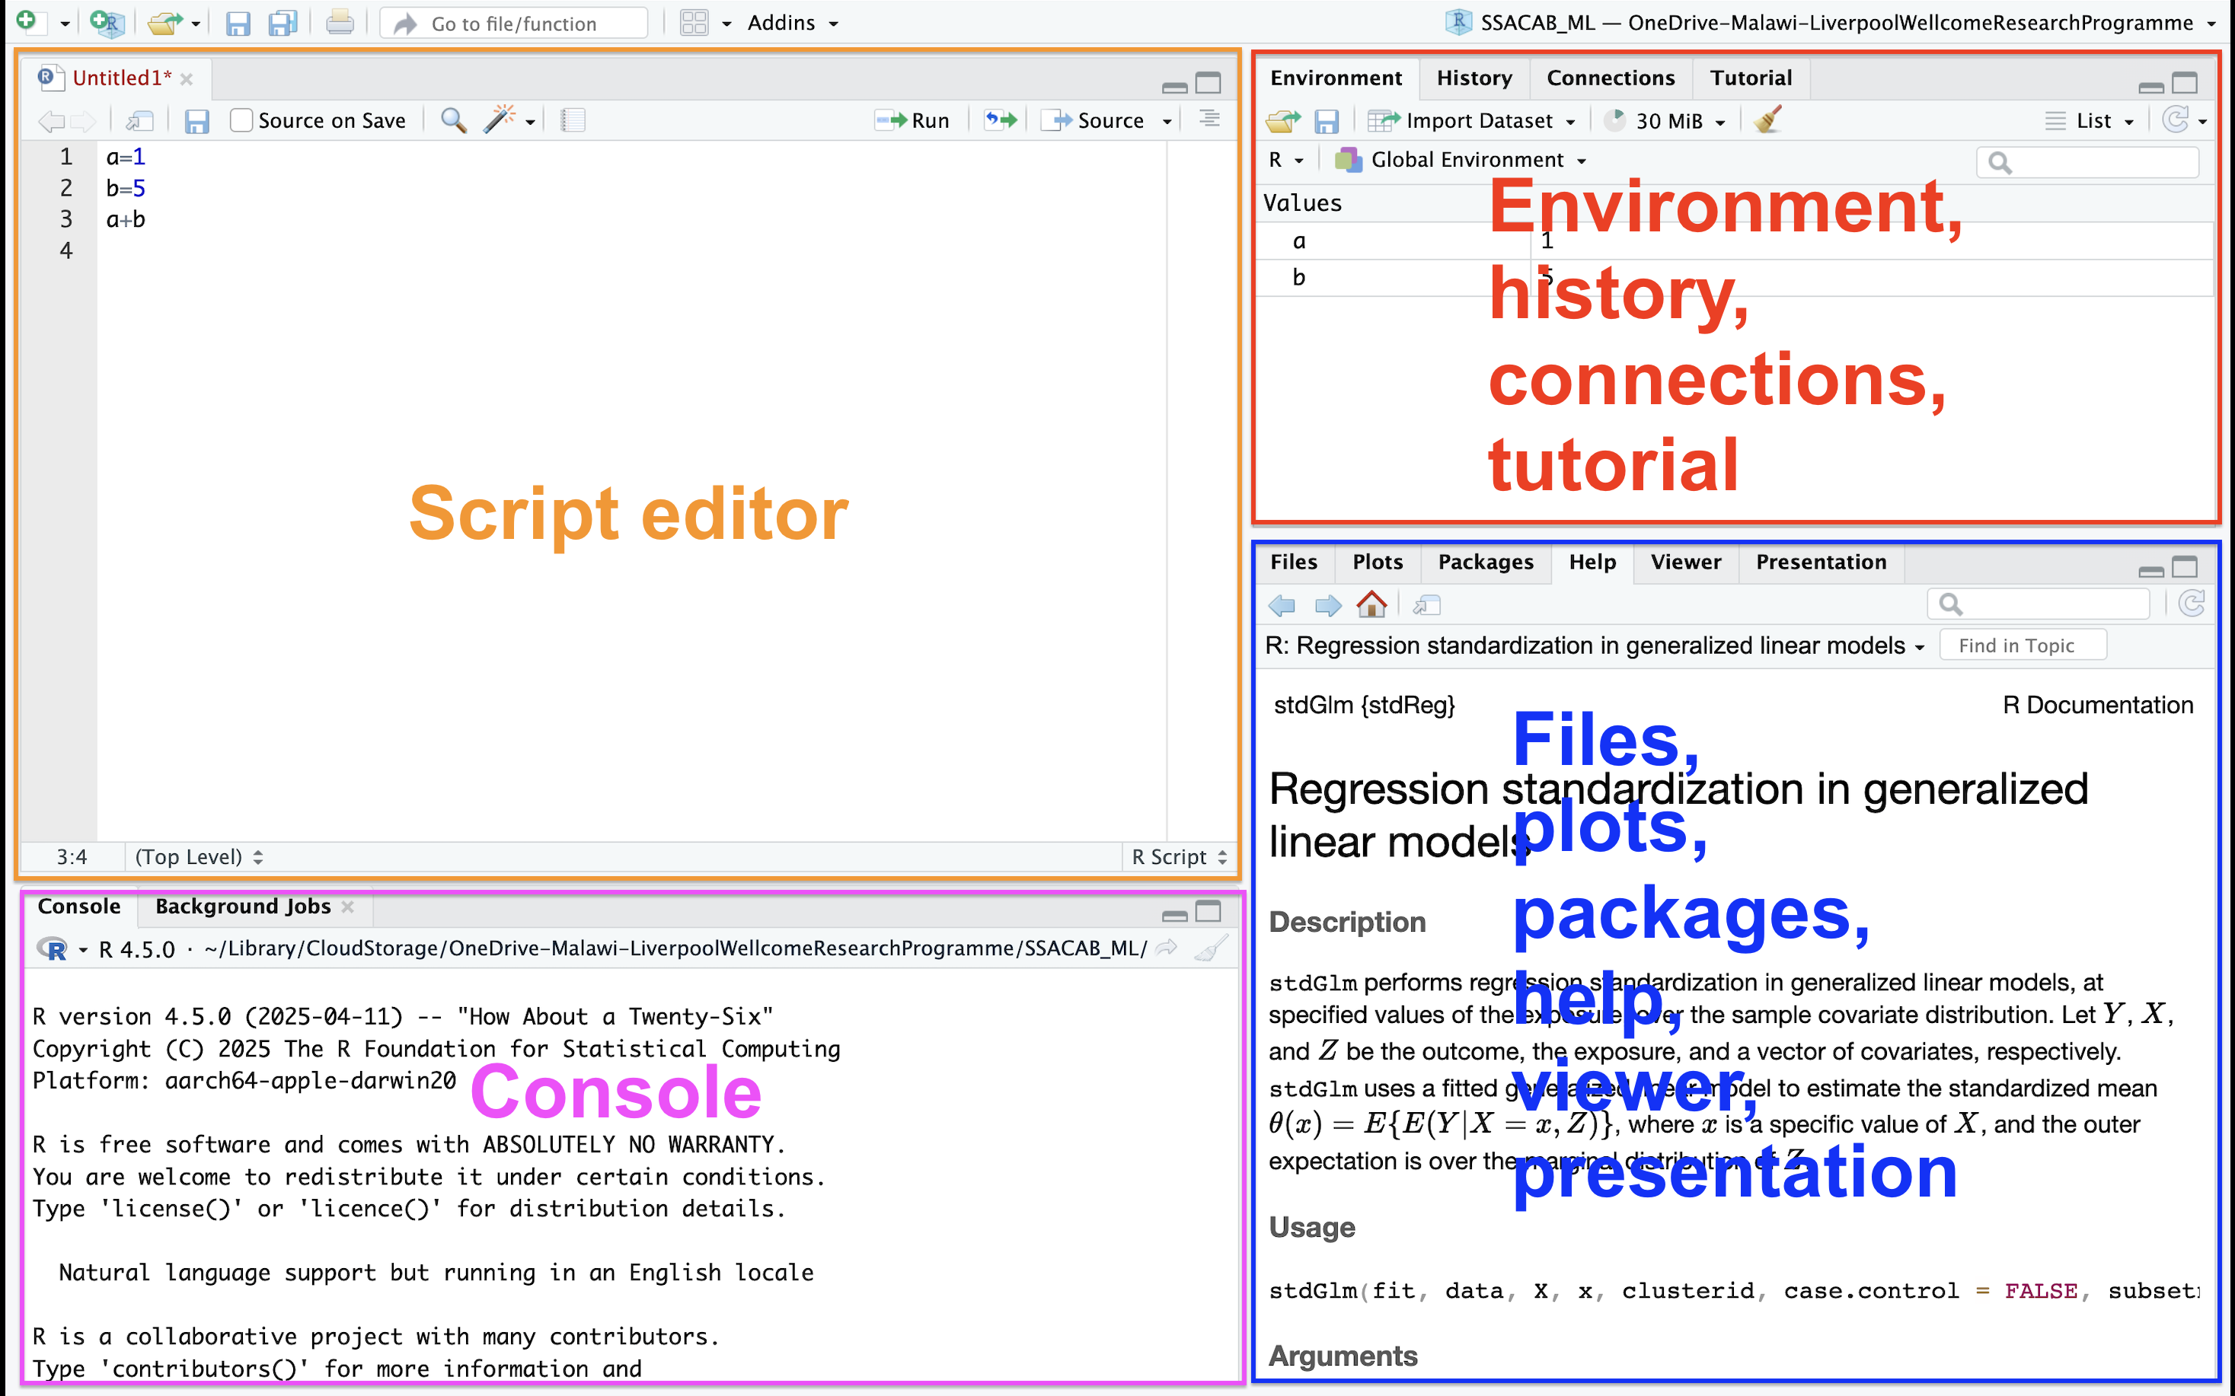
Getting started - R and RStudio IDE
RStudio interace

Slide 16

Getting started - R and RStudio IDE
R workspace: saving & recovering

Slide 17
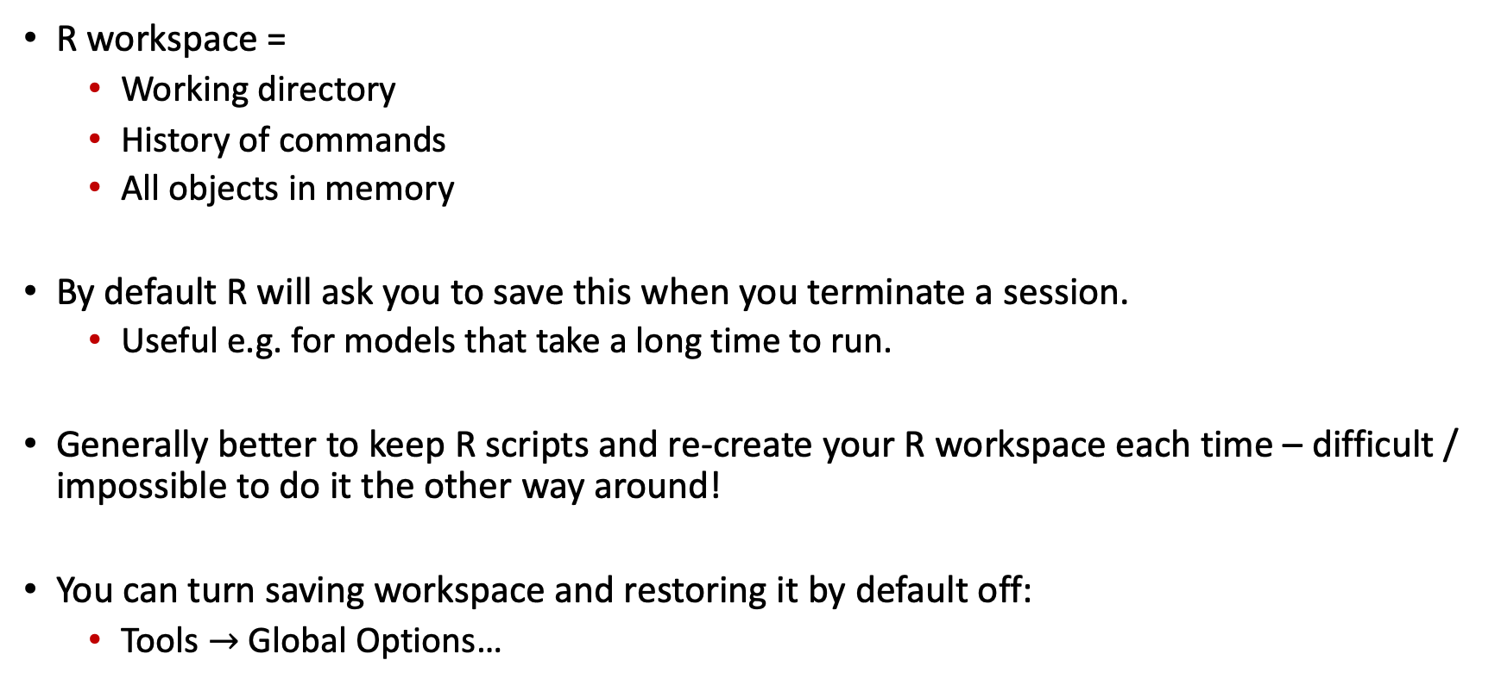
Getting started - workspace
R workspace =
Working directory
History of commands
All objects in memory
By default R will ask you to save this when you terminate a session.
Useful e.g. for models that take a long time to run.
Generally better to keep R scripts and re-create your R workspace each time – difficult / impossible to do it the other way around!
You can turn saving workspace and restoring it by default off:
Tools $→$ Global Options…

Slide 18
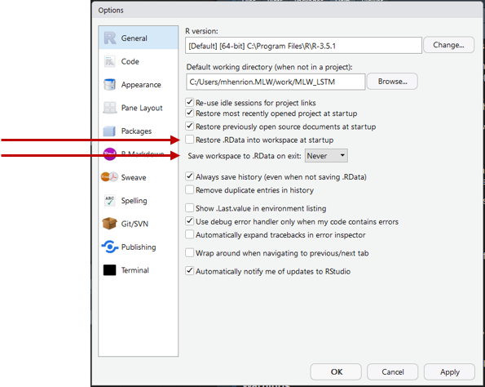
Getting started - workspace

Slide 19
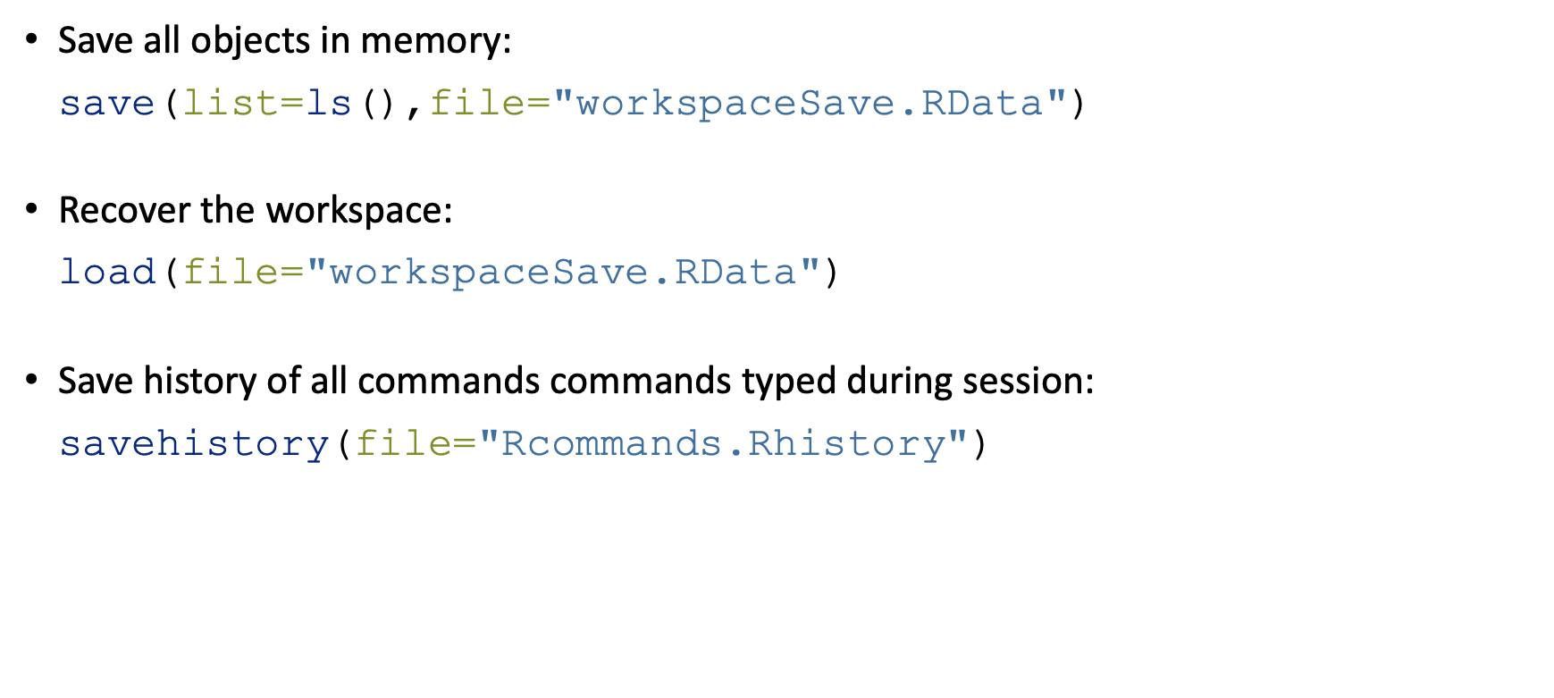
Getting started - workspace
Save all objects in memory:
save(list=ls(),file="workspaceSave.RData")
Recover the workspace:
load(file="workspaceSave.RData")
Save history of all commands commands typed during session:
savehistory(file="Rcommands.Rhistory")

Slide 20
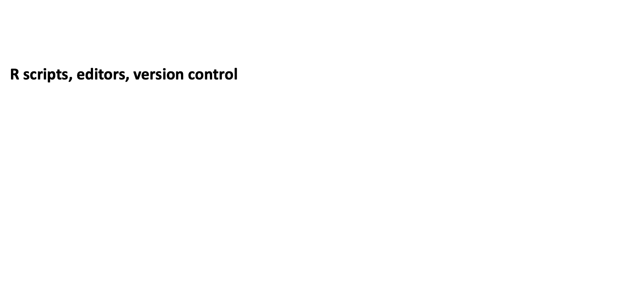
Getting started
R scripts, editors, version control

Slide 21
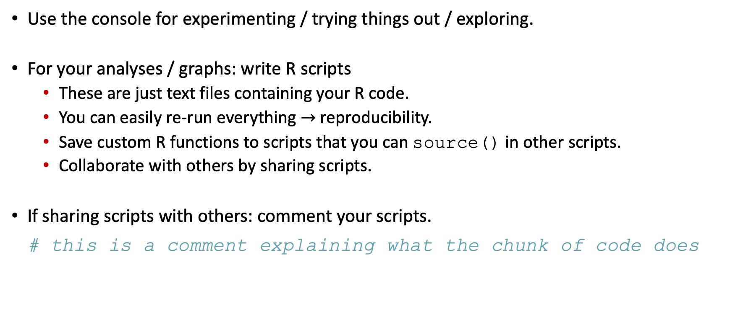
Getting started - R scripts
Use the console for experimenting / trying things out / exploring.
For your analyses / graphs: write R scripts
These are just text files containing your R code.
You can easily re-run everything $→$ reproducibility.
Save custom R functions to scripts that you can source() in other scripts.
Collaborate with others by sharing scripts.
If sharing scripts with others: comment your scripts.
# this is a comment explaining what the chunk of code does

Slide 22
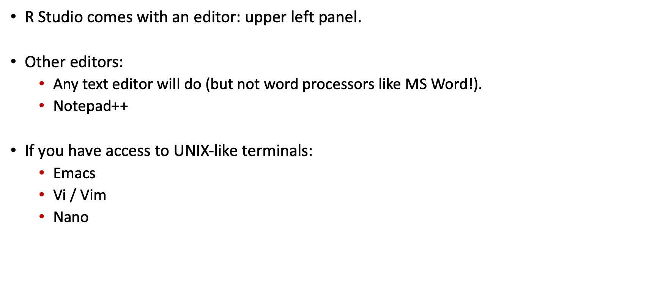
Getting started - Editors
R Studio comes with an editor: upper left panel.
Other editors:
Any text editor will do (but not word processors like MS Word!).
Notepad++
If you have access to UNIX-like terminals:
Emacs
Vi / Vim
Nano

Slide 23
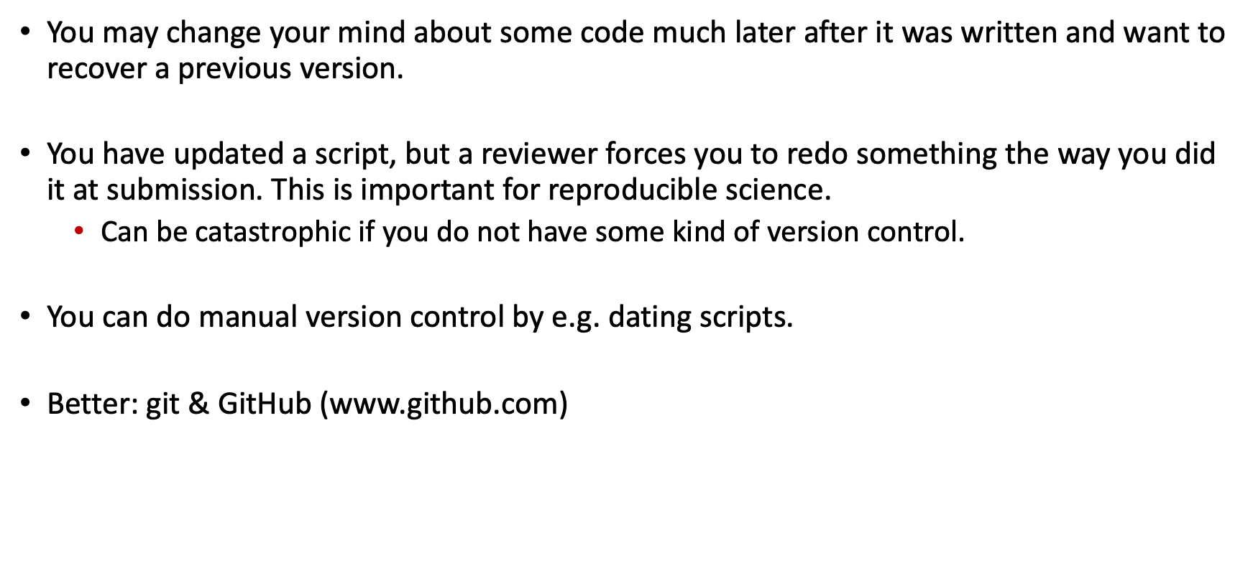
Getting started - Version control
You may change your mind about some code much later after it was written and want to recover a previous version.
You have updated a script, but a reviewer forces you to redo something the way you did it at submission. This is important for reproducible science.
Can be catastrophic if you do not have some kind of version control.
You can do manual version control by e.g. dating scripts.
Better: git & GitHub (www.github.com)

Slide 24

Getting started
Resources

Slide 25
Getting started - Resources
R help files
Type ? followed by the name of the command you want to get help on.
Type help.start() to open manuals, FAQs and other material.
swirl R package
Install the swirl package (type install.packages("swirl) at the console), load the package (library(swirl)) then run swirl() at the console and choose a course to follow.
CRAN
Tutorials & manuals: https://cran.r-project.org/manuals.html
Task views: https://cran.r-project.org/web/views/
RStudio
Cheatsheets: https://posit.co/resources/cheatsheets/
The Epidemiologist R handbok:
Online textbook: https://www.epirhandbook.com/
Text books
Many, but this one is excellent and free: http://r4ds.hadley.nz/
Online tutorials, blogs, forums
Why R? webinars http://whyr.pl/foundation/webinars/
R-bloggers https://www.r-bloggers.com/
Stack overflow https://stackoverflow.com/questions/tagged/r
R Graph Gallery https://www.r-graph-gallery.com/

Slide 26
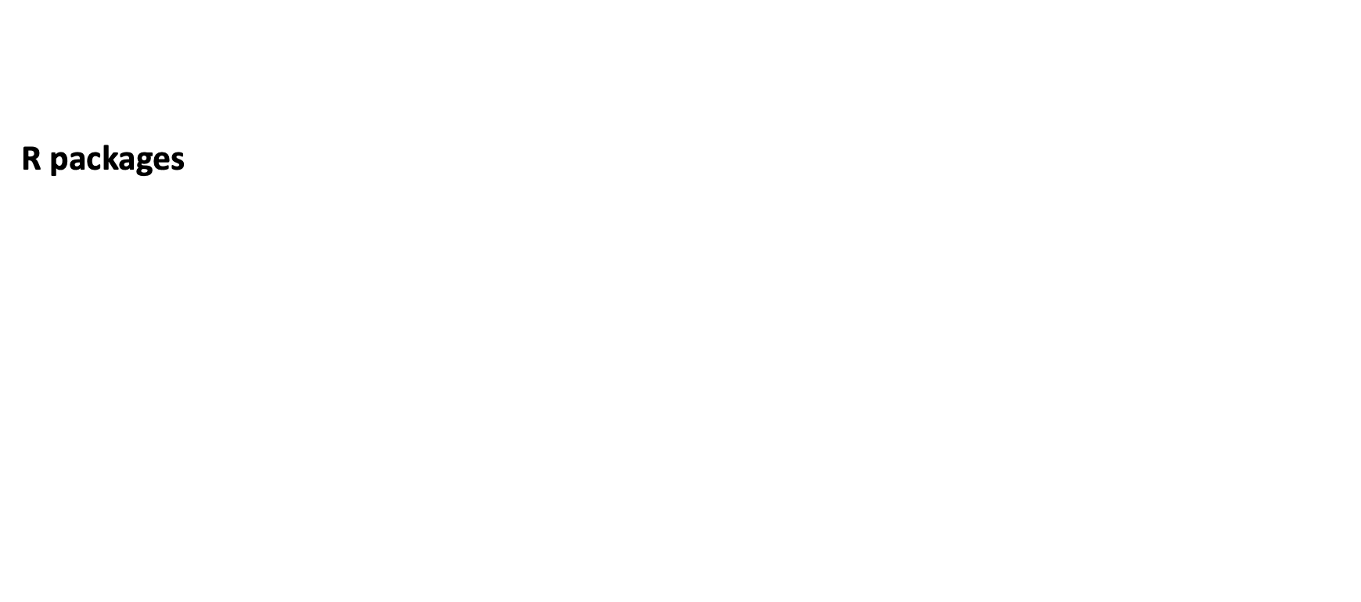
Getting started
R packages

Slide 27
Getting started - R packages
R is stand-alone and you can code any functions you need for your analysis.
Easier to use R packages: pre-coded sets of R functions and data.
In fact, a standard installation of R comes with 15 core and 15 recommended packages:
Base: base, compiler, datasets, graphics, grDevices, grid, methods, parallel, splines, stats, stats4, tcltk, tools, translations, utils
Recommended: KernSmooth, MASS, Matrix, boot, class, cluster, codetools, foreign, lattice, mgcv, nlme, nnet, rpart, spatial, survival
Packages are hosted either on the Comprehensive R Archive Network (CRAN, https://cran.r-project.org) or on Bioconductor (https://bioconductor.org). CRAN is the most commonly used of these with Bioconductor packages mostly targeted at bioinformaticians.

Slide 28
Getting started - R packages
You install packages from CRAN by using the install.packages() function.
For example:
install.packages("tidyverse") install.packages("lubridate")
And you load packages by using the function library(), for example:
library(tidyverse) library(lubridate) library(gridExtra)

Slide 29
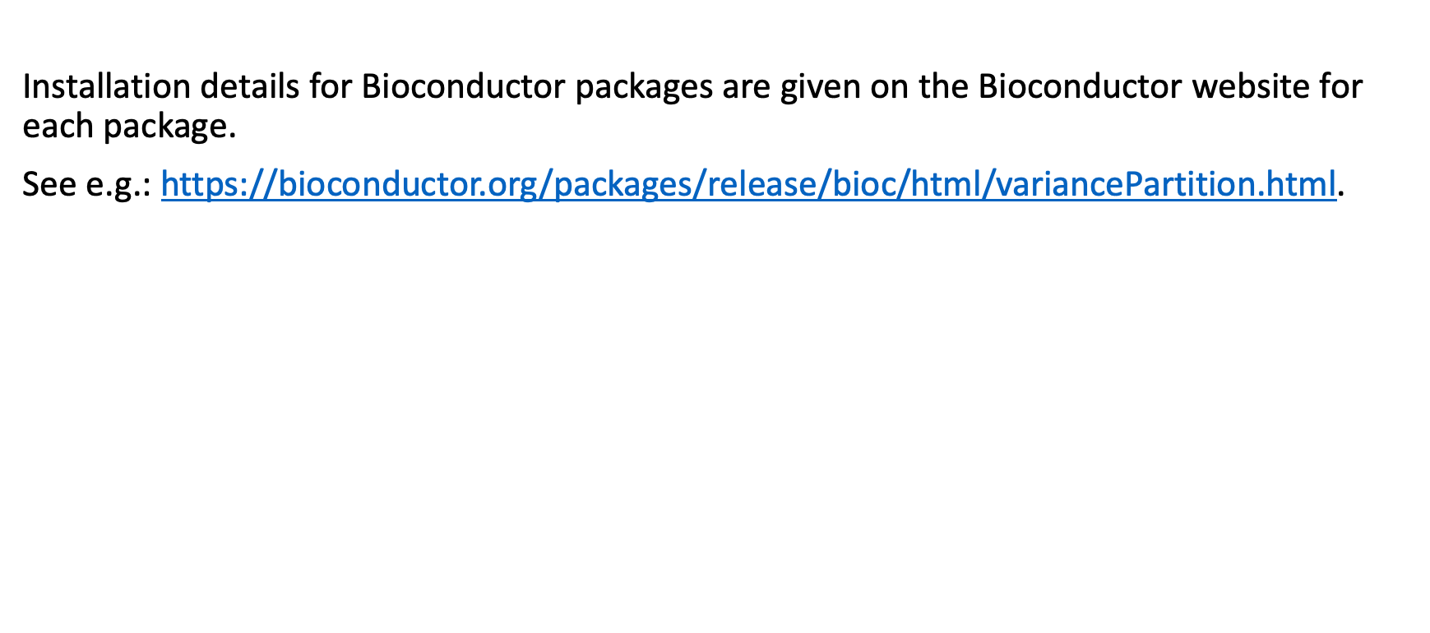
Getting started - R packages
Installation details for Bioconductor packages are given on the Bioconductor website for each package.
See e.g.: https://bioconductor.org/packages/release/bioc/html/variancePartition.html.

Slide 30
Reading and writing data

Slide 31
Reading and writing data
As the most basic task for any analysis in R, you need to be able to read your data into R and, at the end, write the results to a file on your hard drive.
Let’s start by using some data that R comes with, write it out to the disk, then read it back in.
The dataset iris is a famous dataset recording 150 observations of 3 species of flowers. It was extensively used by Ronald Fisher as he developed his statistical theory. Find out more about the data by typing ?iris at the R console.

Slide 32

Reading and writing data
Writing data to disk

Slide 33
Reading and writing data - Writing data
We will use iris which is a data frame of 150 rows and 5 columns (variables Sepal.Length, Sepal.Width, Petal.Width, Species). If you want to see another way of storing the same data, have a look at iris3 - a 3-dimensional array.
head(iris) ## Sepal.Length Sepal.Width Petal.Length Petal.Width Species ## 1 5.1 3.5 1.4 0.2 setosa ## 2 4.9 3.0 1.4 0.2 setosa ## 3 4.7 3.2 1.3 0.2 setosa ## 4 4.6 3.1 1.5 0.2 setosa ## 5 5.0 3.6 1.4 0.2 setosa ## 6 5.4 3.9 1.7 0.4
setosa

Slide 34
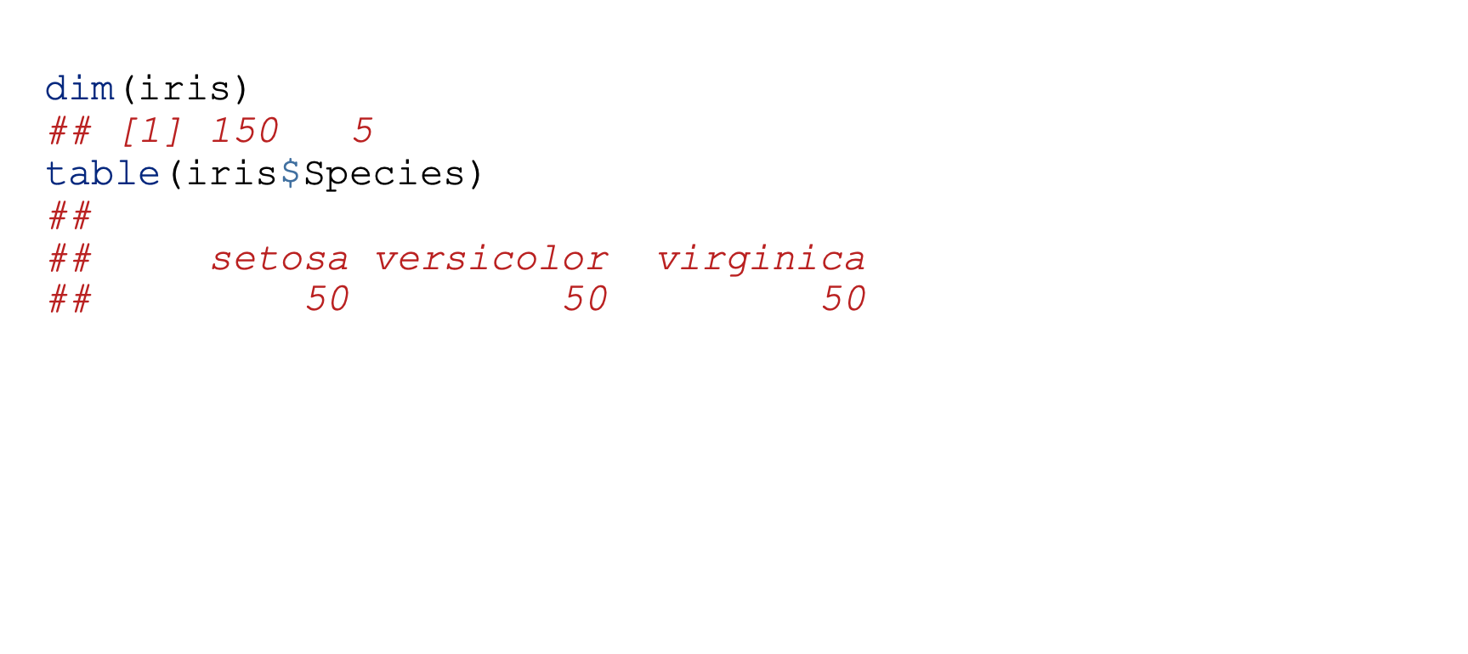
Reading and writing data - Writing data
dim(iris) ## [1] 150 5 table(iris$Species) ## ## setosa versicolor virginica ## 50 50 50

Slide 35
Reading and writing data - Writing data
Now, let’s write this as a comma-separated file:
dir.create("dataAndSupportDocs",showWarnings=FALSE) # creates a directory write.csv(iris,file="dataAndSupportDocs/iris.csv",row.names=FALSE) # saves the data to a csv file
Check on your hard drive, you will now have a file named iris.csv (inside a directory named dataAndSupportDocs) which you can open with a text editor, Excel, …

Slide 36

Reading and writing data
Reading data from disk

Slide 37
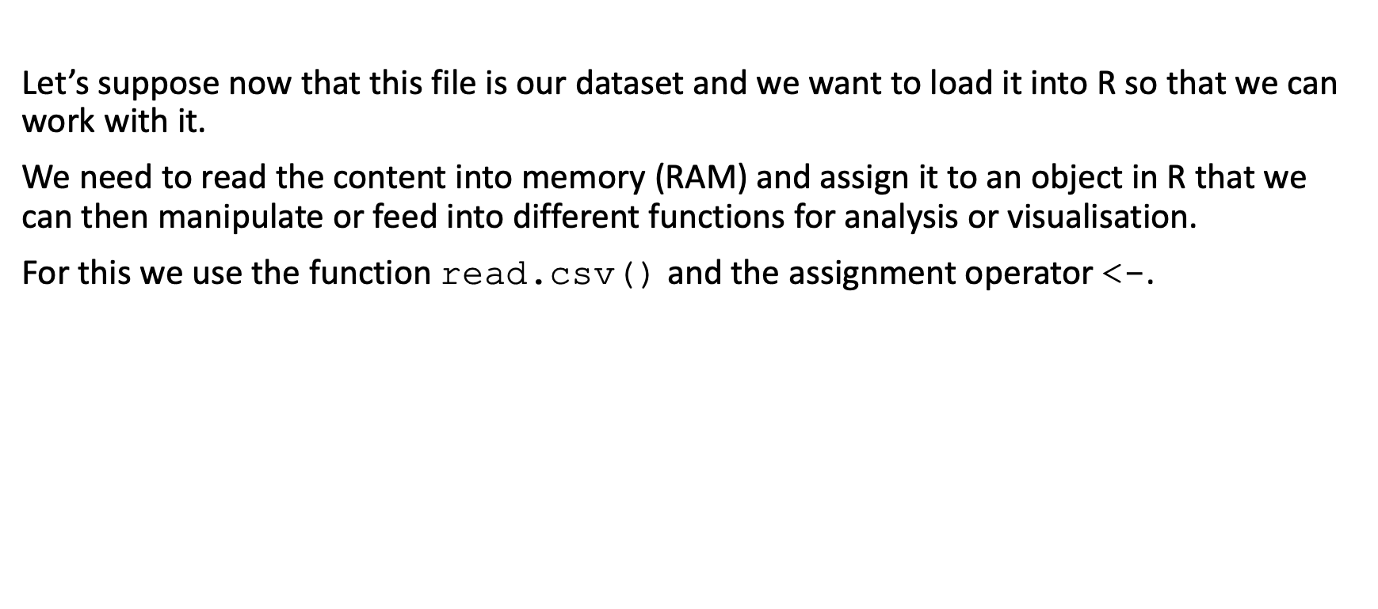
Reading and writing data - Reading data
Let’s suppose now that this file is our dataset and we want to load it into R so that we can work with it.
We need to read the content into memory (RAM) and assign it to an object in R that we can then manipulate or feed into different functions for analysis or visualisation.
For this we use the function read.csv() and the assignment operator <-.

Slide 38
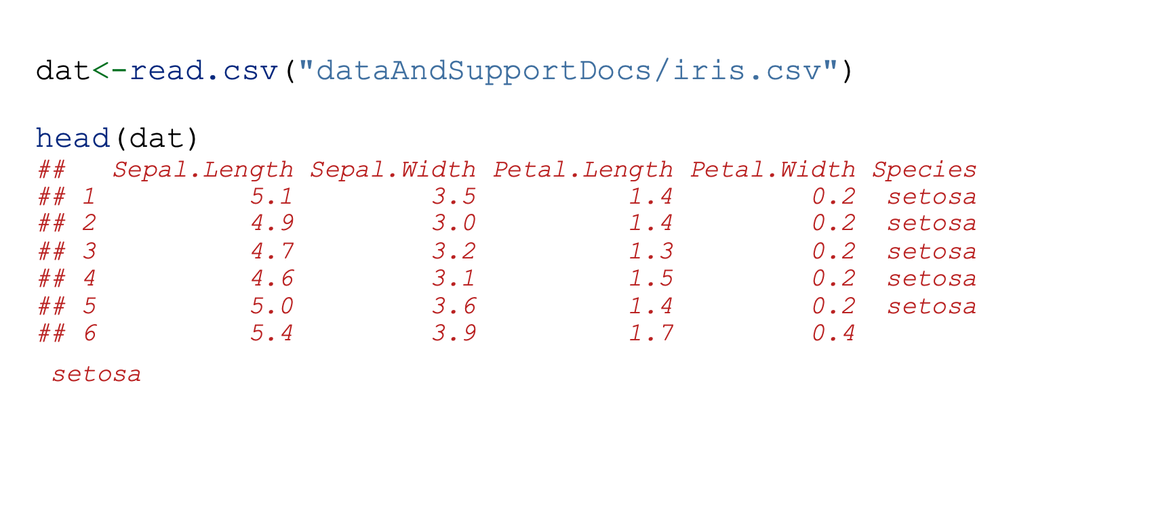
Reading and writing data - Reading data
dat<-read.csv("dataAndSupportDocs/iris.csv") head(dat) ## Sepal.Length Sepal.Width Petal.Length Petal.Width Species ## 1 5.1 3.5 1.4 0.2 setosa ## 2 4.9 3.0 1.4 0.2 setosa ## 3 4.7 3.2 1.3 0.2 setosa ## 4 4.6 3.1 1.5 0.2 setosa ## 5 5.0 3.6 1.4 0.2 setosa ## 6 5.4 3.9 1.7 0.4
setosa

Slide 39
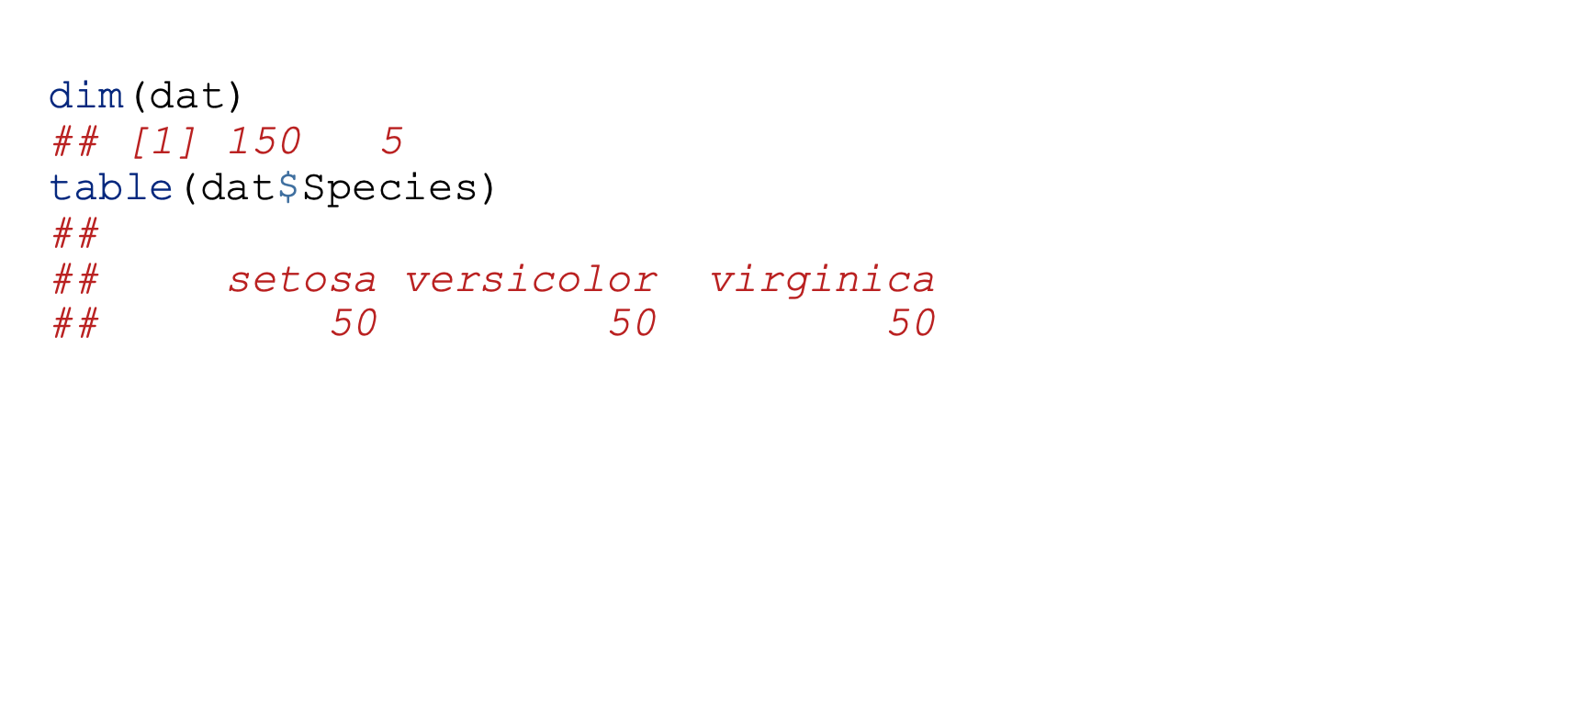
Reading and writing data - Reading data
dim(dat) ## [1] 150 5 table(dat$Species) ## ## setosa versicolor virginica ## 50 50 50

Slide 40
Reading and writing data - Reading data
There are alternatives: the more general function read.table() or the function read_csv() from the R package readr which is one package contained in a set known as the tidyverse.
read_csv() will store the data as a tibble which is a special type of data frame.
dat2<-read.table(sep=",",header=T,file="dataAndSupportDocs/iris.csv") dim(dat2) ## [1] 150 5 table(dat2$Species) ## ## setosa versicolor virginica ## 50 50 50

Slide 41
Reading and writing data - Reading data
# library(tidyverse)
dat3<-read_csv("dataAndSupportDocs/iris.csv")
## Rows: 150 Columns: 5 ## ── Column specification ──────────────────────────────────────────────────────── ## Delimiter: "," ## chr (1): Species ## dbl (4): Sepal.Length, Sepal.Width, Petal.Length, Petal.Width ## ## ℹ Use `spec()` to retrieve the full column specification for this data. ## ℹ Specify the column types or set `show_col_types = FALSE` to quiet this message. dim(dat3) ## [1] 150 5 table(dat3$Species) ## ## setosa versicolor virginica ## 50 50 50

Slide 42
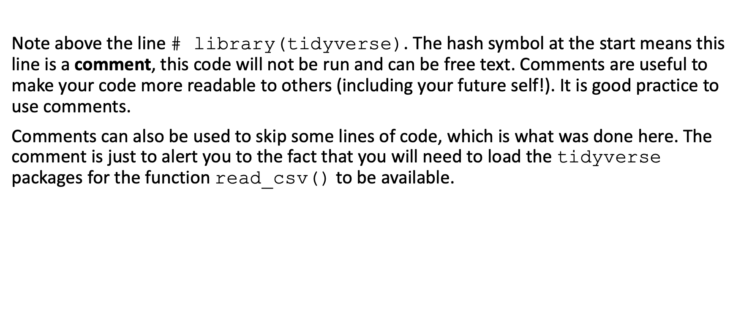
Reading and writing data - Reading data
Note above the line # library(tidyverse). The hash symbol at the start means this line is a comment, this code will not be run and can be free text. Comments are useful to make your code more readable to others (including your future self!). It is good practice to use comments.
Comments can also be used to skip some lines of code, which is what was done here. The comment is just to alert you to the fact that you will need to load the tidyverse packages for the function read_csv() to be available.

Slide 43
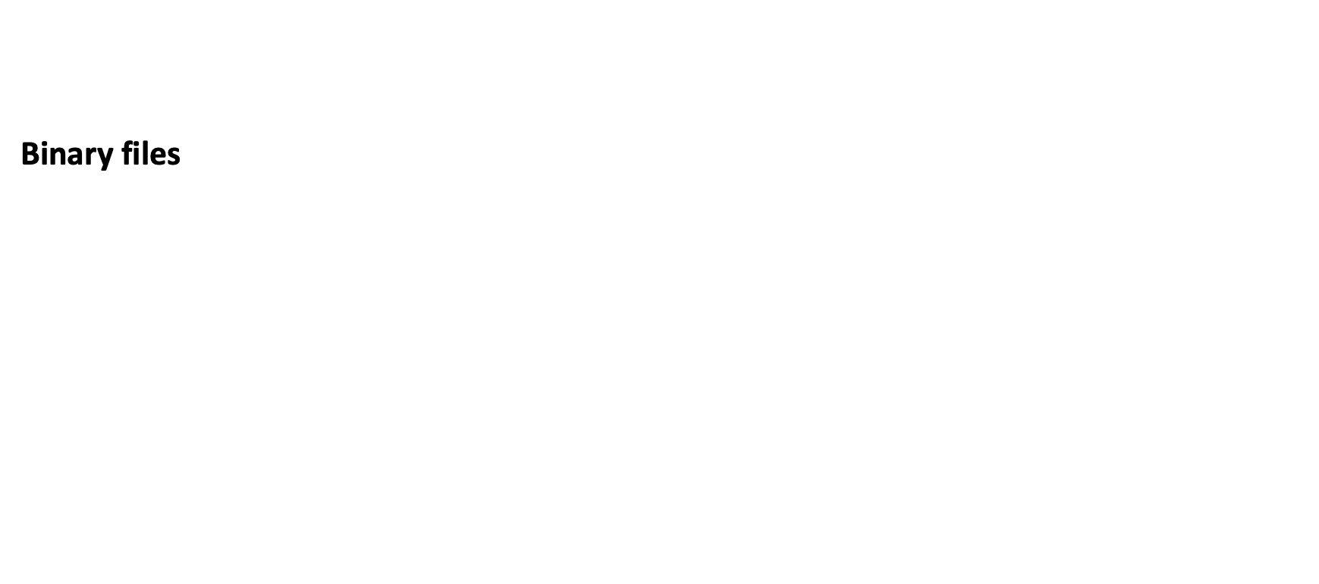
Reading and writing data
Binary files

Slide 44
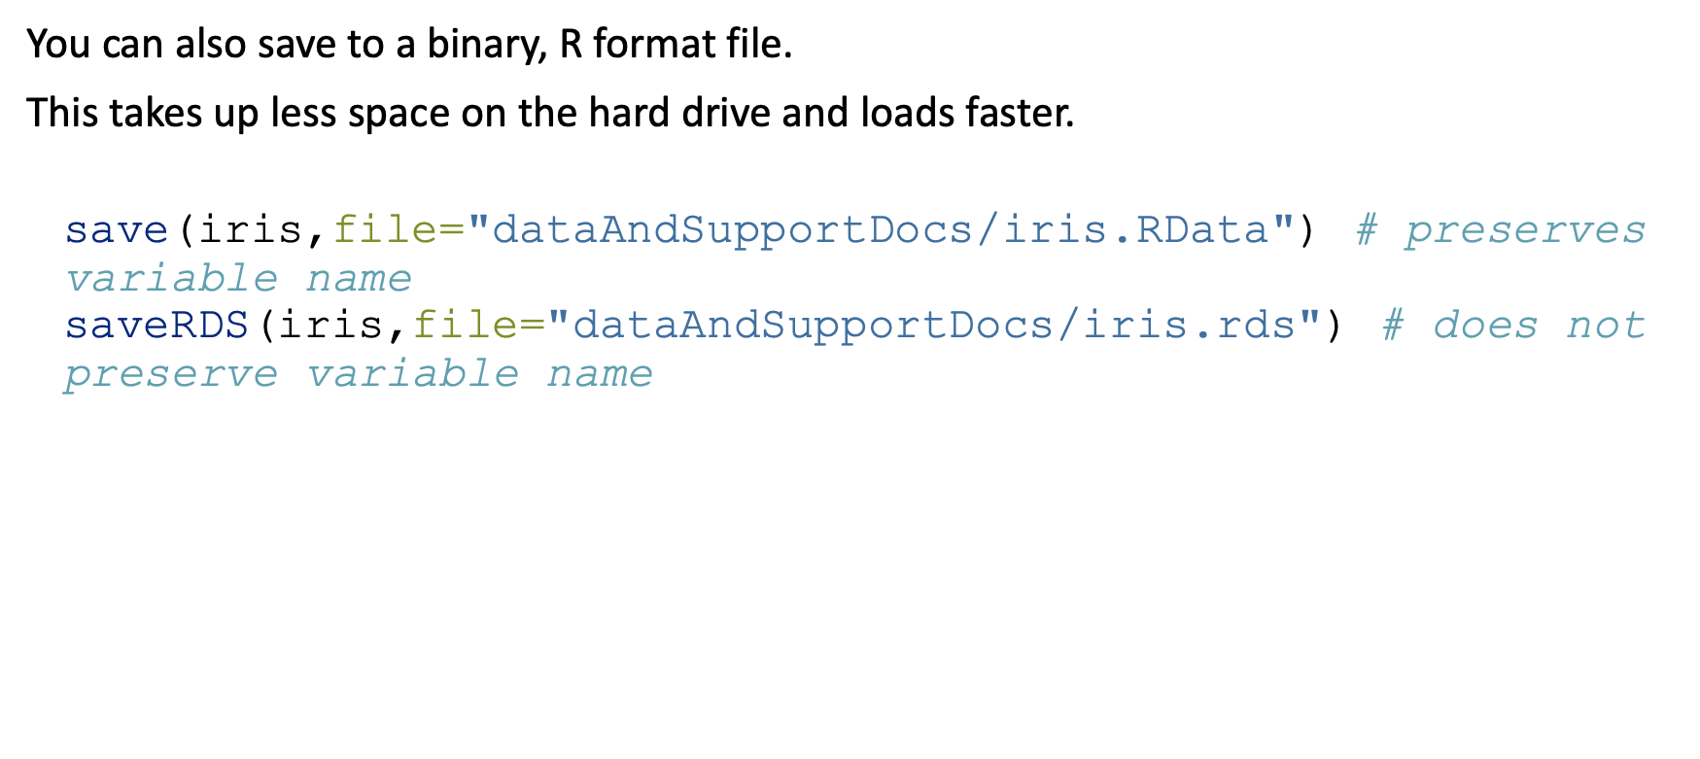
Reading and writing data - binary files
You can also save to a binary, R format file.
This takes up less space on the hard drive and loads faster.
save(iris,file="dataAndSupportDocs/iris.RData") # preserves variable name saveRDS(iris,file="dataAndSupportDocs/iris.rds") # does not preserve variable name

Slide 45
Reading and writing data - binary files
load() for saved workspaces and objects saved using save(). Object names in R will be the same as when they were saved, no object assignment:
load("dataAndSupportDocs/iris.RData")
readRDS() for objects saved using saveRDS(). Need to assign to an object:
obj<-readRDS("dataAndSupportDocs/iris.rds")

Slide 46
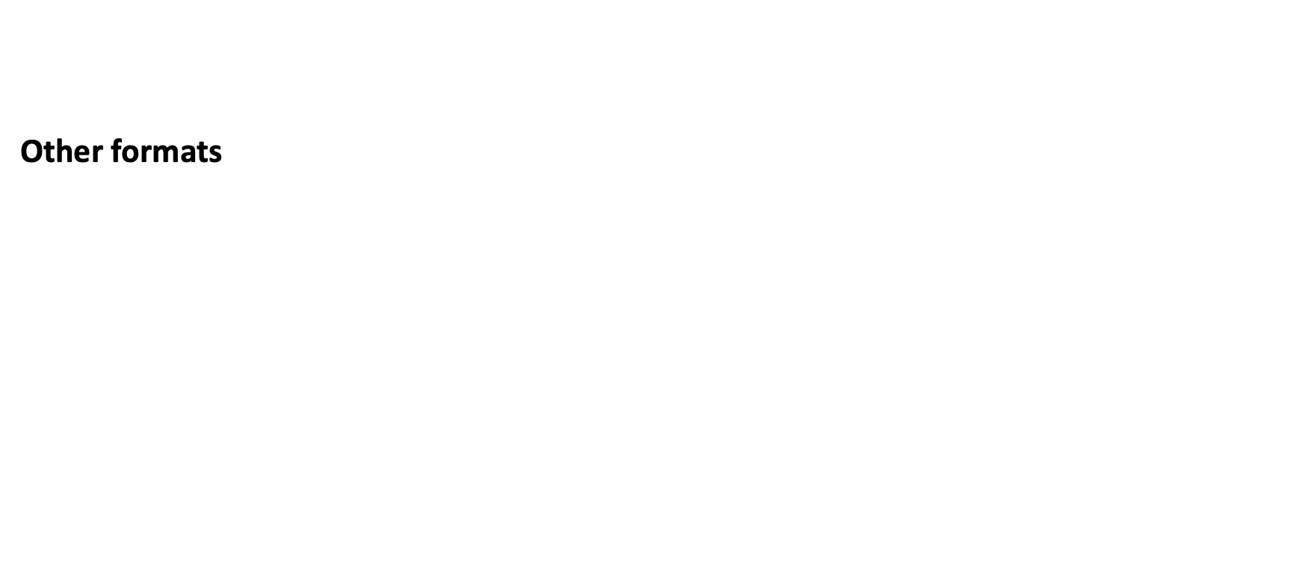
Reading and writing data
Other formats

Slide 47
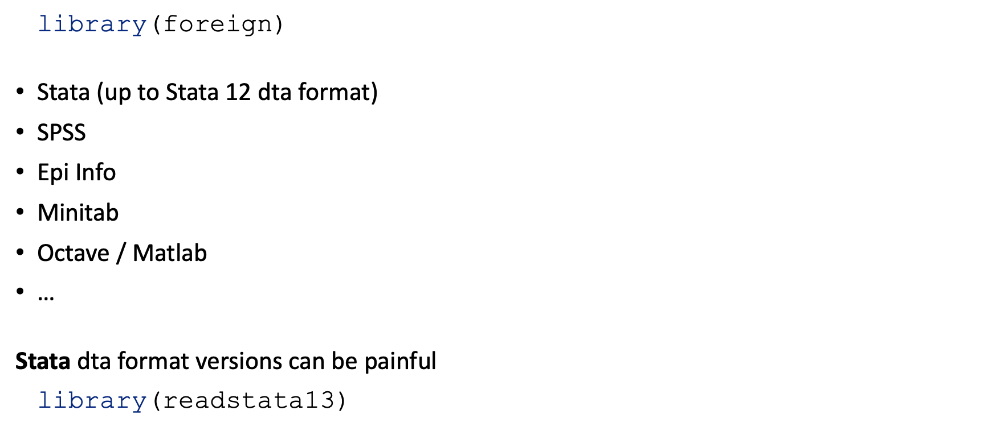
Reading and writing data - Other formats
library(foreign)
Stata (up to Stata 12 dta format)
SPSS
Epi Info
Minitab
Octave / Matlab
…
Stata dta format versions can be painful
library(readstata13)

Slide 48
Reading and writing data - Other formats
Excel and other spreadsheets
Tricky: several sheets, formulae, macros, …
Best: export as text file
Otherwise:
library(xlsx) library(XLConnect) library(readxl) # the most commonly used of these
Can also write Excel formats:
library(xlsx) library(dataframes2xls) # xls only library(WriteXLS) # xls only

Slide 49
Reading and writing data - Other formats
Relational databases
Front-end + database management system (DBMS) specific back-end:
library(DBI) # front-end
library(RMySQL) # back-end library(ROracle) # back-end library(RPostgreSQL) # back-end library(RSQLite) # back-end
Interact with any open database connectivity DBMS:
Very versatile
Same R code for different database systems
library(RODBC)

Slide 50
Working with data

Slide 51
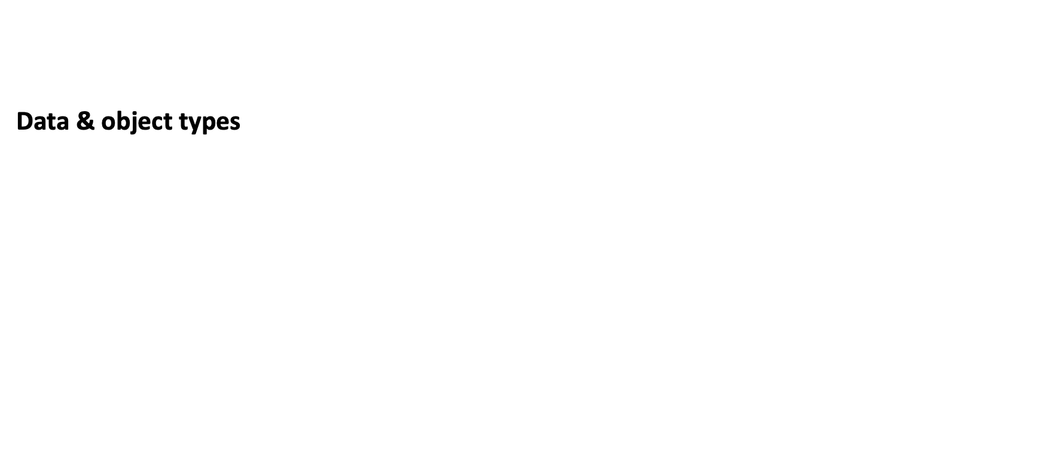
Working with data
Data & object types

Slide 52
Working with data - Data & object types
A variable has one of 4 levels of measurement:
nominal - classifies observations into different categories
alive / dead
human, fish, goat, bird
ordinal - different categories, but categories are ordered
low, medium, high
interval - ordered data with degree of difference; ratios not meaningful
temperature in centigrade: difference betwen 10º and 20º same as between 50º and 60º but 20º not twice as hot as 10º
ratio - interval data with a unique, non arbitrary zero value; ratios meaningful
temperature in Kelvin
length

Slide 53
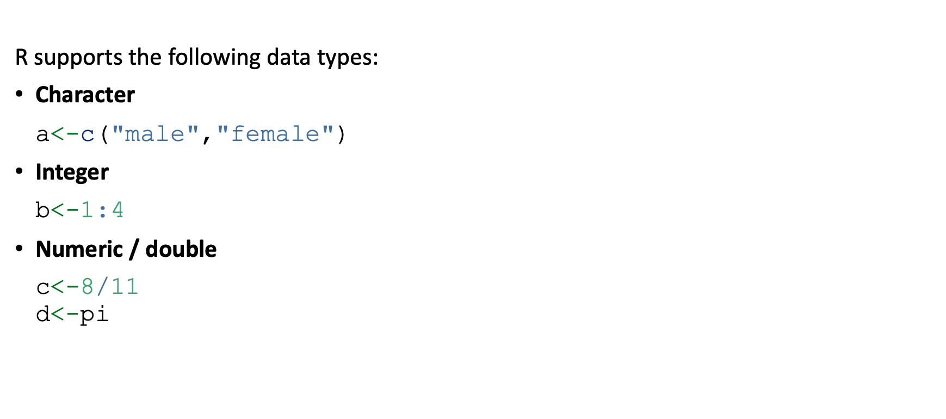
Working with data - Data & object types
R supports the following data types:
Character
a<-c("male","female")
Integer
b<-1:4
Numeric / double
c<-8/11 d<-pi

Slide 54
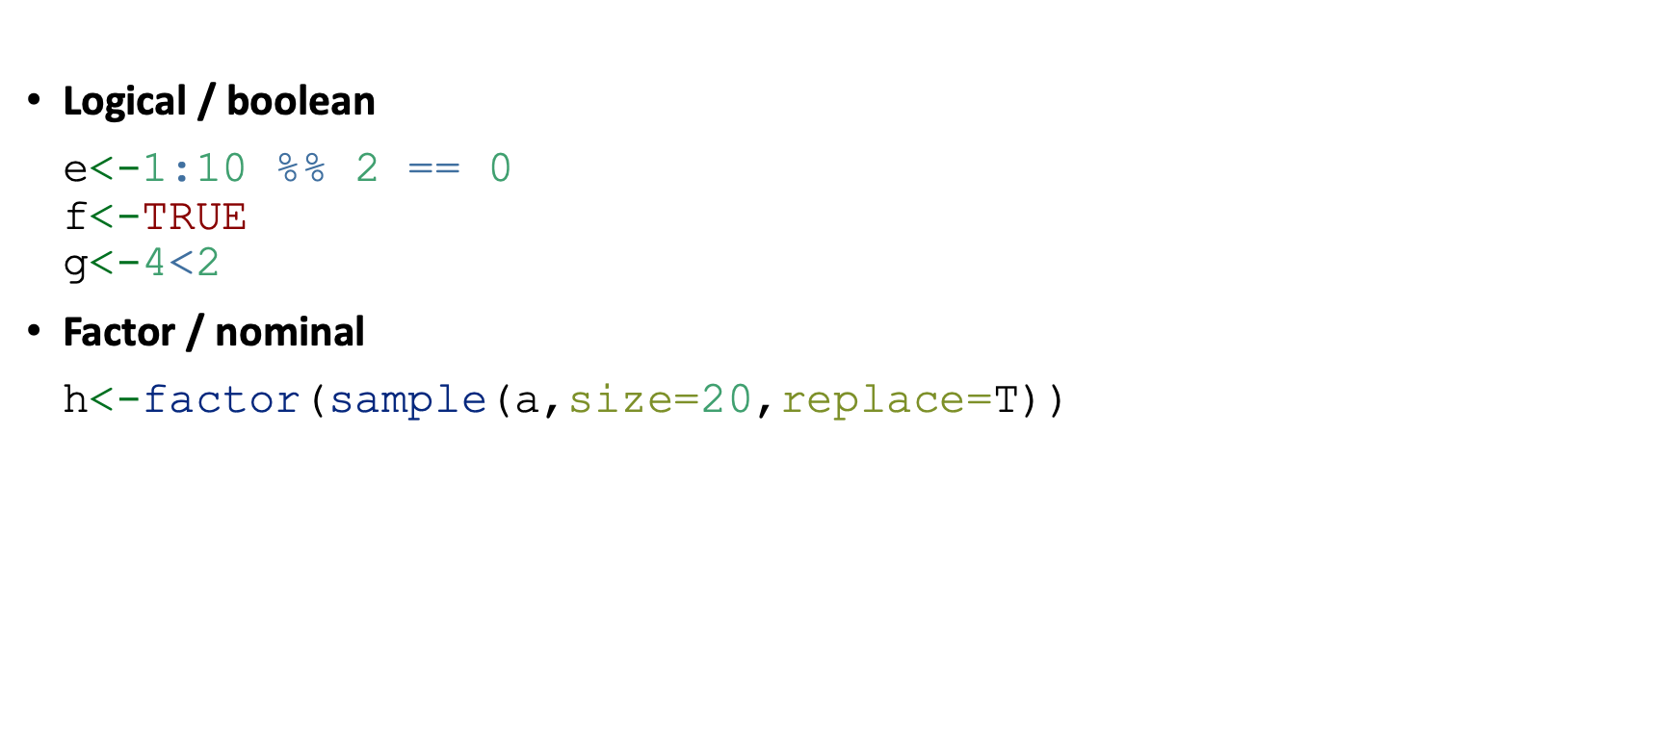
Working with data - Data & object types
Logical / boolean
e<-1:10 %% 2 == 0 f<-TRUE g<-4<2
Factor / nominal
h<-factor(sample(a,size=20,replace=T))

Slide 55
Working with data - Data & object types
Dates & date-times
Dates are a special type of data and require special functions to work with. By far the most helpful package is lubridate. It allows you to easily parse date format, using functions like ymd(), ymd_hms(), ym()…
See the lubridate cheat sheet for more information.
ymd("2022-06-04") ## [1] "2022-06-04" ymd("2022 June 4") ## [1] "2022-06-04"

Slide 56
Working with data - Data & object types
Dates & date-times
ymd_hms("2022-06-04 10:00:00") ## [1] "2022-06-04 10:00:00 UTC" ym("2022-06") ## [1] "2022-06-01" ymd("2022-06-04") - ymd("2021-03-02") ## Time difference of 459 days

Slide 57
Working with data - Data & object types
Object types
Vectors
A single number or word is just a vector of length 1.
You can create vectors with the function c().
E.g. v1<-c(1,2,-12.34,5/6)
Shorthands for certain types of vectors, e.g. v2<-1:10
You can access individual elements of a vector, e.g. 3rd element v1[3]
Matrices
Matrices hold data tables (rows and columns).
All elements of a matrix need to be of the same type (e.g. all numeric or all character).
You can create matrices with the function matrix().
E.g. m1<-matrix(nrow=2,byrow=TRUE,1:16)
You can access individual elements of a matrix, e.g. 2nd row, 3rd column m1[2,3]

Slide 58
Working with data - Data & object types
Object types (cont’d)
Arrays
Generalise matrices to have any number of dimensions (i.e. more than just 2, e.g. 3x3x2).
Not used that commonly.
E.g. a1<-table(mtcars$cyl,mtcars$gear,mtcars$am)
You can access individual elements of an array, e.g. a1[3,1,2]
Lists
Lists are very flexible objects that can hold several elements.
Each element can be of a different type.
Elements can (but don’t need to) be named.
E.g. l1<-list(wordVector=c("hello","how","are","you","?"),numberMatrix=matrix(nrow=3,1:9))
You can access individual elements, e.g. first element l1[[1]] or by name l1$wordVector

Slide 59
Working with data - Data & object types
Object types (cont’d)
Data frames
This is the most common object you will use to work with data, e.g. read.table() returns a data frame.
Data frames are like matrices in that they provide a data table (rows and columns) but unlike matrices allow different data types for different columns.
Technically data frames are special types of lists. This means that you can access individual columns / variables by using the $ notation.
E.g. df1<-data.frame(pid=1:5,name=c("Chimwemwe","Esther","John","Dalitso","Julie")) or object dat from earlier.
You can access individual variables, e.g. df1$name or df1[,"name"] or df[,2].
You can access individual rows, e.g. df1[1,].
You can access individual elements, e.g. df1[3,2] or df$name[3]

Slide 60
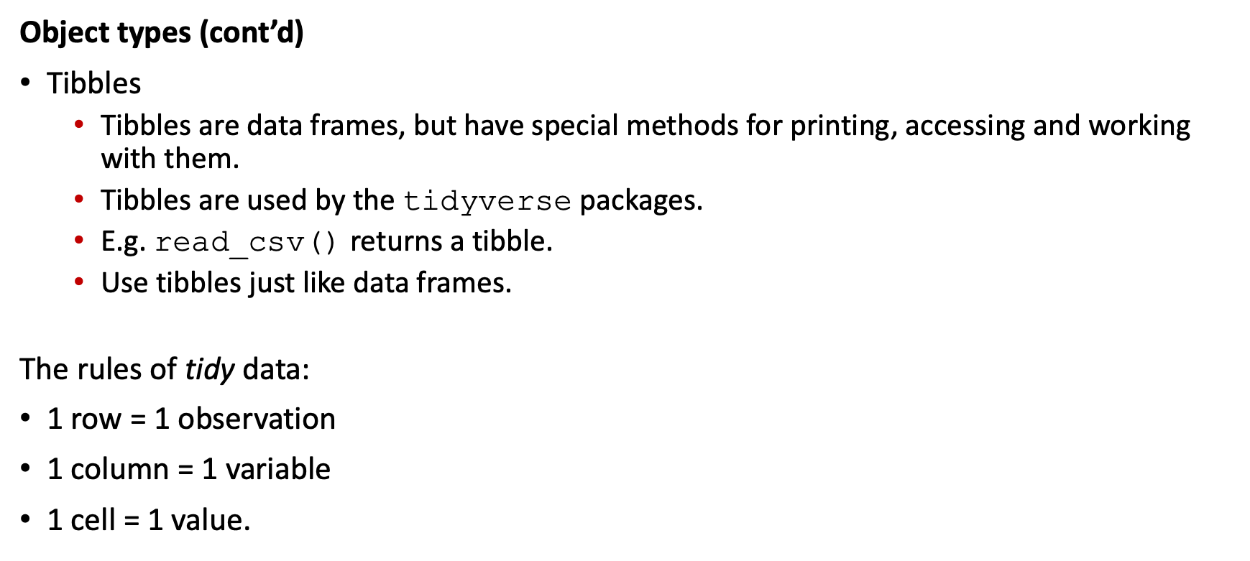
Working with data - Data & object types
Object types (cont’d)
Tibbles
Tibbles are data frames, but have special methods for printing, accessing and working with them.
Tibbles are used by the tidyverse packages.
E.g. read_csv() returns a tibble.
Use tibbles just like data frames.
The rules of tidy data:
1 row = 1 observation
1 column = 1 variable
1 cell = 1 value.

Slide 61
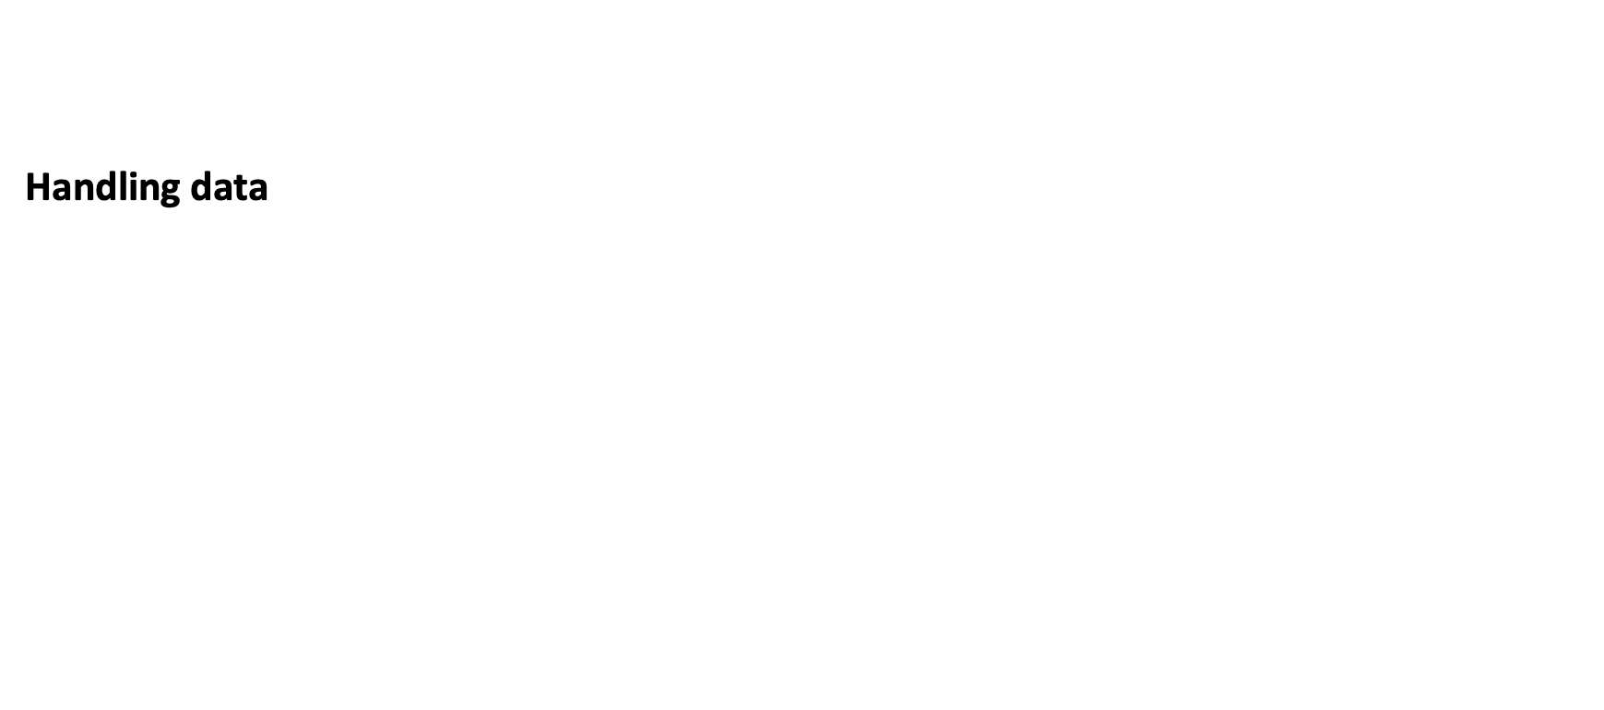
Working with data
Handling data

Slide 62
Working with data - handling data
Often you only want to work with a subset of your data. This may be that you are interested only in one group of observations or that you may want to get rid of irrelevant variables. The dplyr package provides 2 easy to use function for this: filter and select.
filter() allows filtering out only certain observations
select() allows selecting specific variables
For example:
filter(.data=iris,Species=="setosa") # only 'setosa' observations select(.data=iris,Petal.Width,Petal.Length) # only the Petal.Width and Petal.Length variables

Slide 63
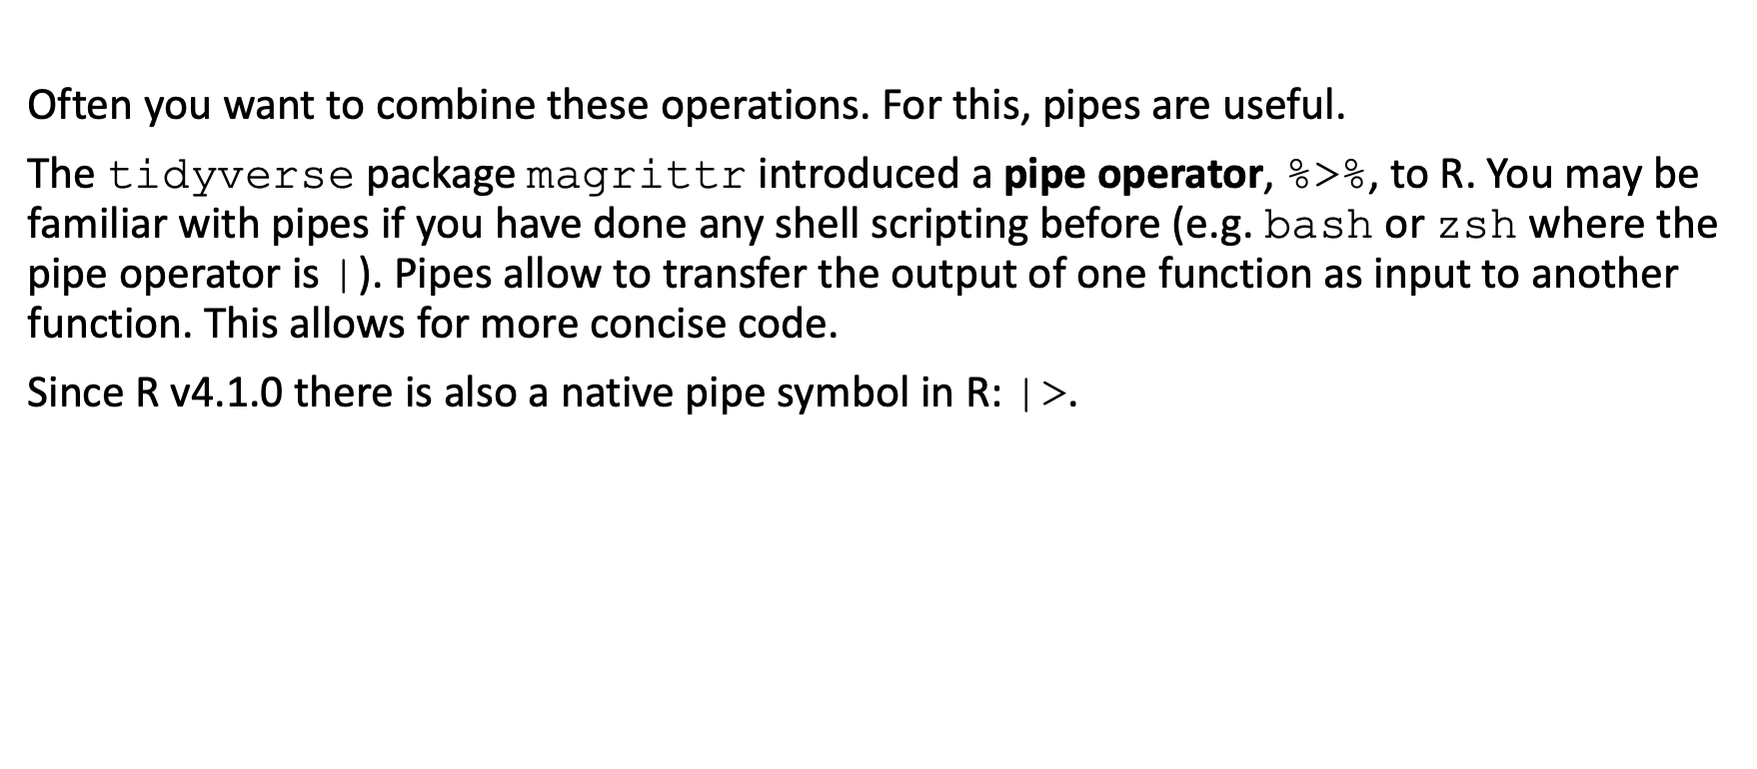
Working with data - handling data
Often you want to combine these operations. For this, pipes are useful.
The tidyverse package magrittr introduced a pipe operator, %>%, to R. You may be familiar with pipes if you have done any shell scripting before (e.g. bash or zsh where the pipe operator is |). Pipes allow to transfer the output of one function as input to another function. This allows for more concise code.
Since R v4.1.0 there is also a native pipe symbol in R: |>.

Slide 64
Working with data - handling data
For example:
iris %>% filter(Species=="setosa") %>% select(Petal.Width,Petal.Length) %>% head(n=5) ## Petal.Width Petal.Length ## 1 0.2 1.4 ## 2 0.2 1.4 ## 3 0.2 1.3 ## 4 0.2 1.5 ## 5 0.2 1.4

Slide 65
Working with data - handling data
iris |> filter(Species=="setosa") |> select(Petal.Width,Petal.Length) |> head(n=5) ## Petal.Width Petal.Length ## 1 0.2 1.4 ## 2 0.2 1.4 ## 3 0.2 1.3 ## 4 0.2 1.5 ## 5 0.2 1.4

Slide 66
Working with data - handling data
To create new variables from existing ones, you can use the function mutate() (add new variables and preserve existing ones) and transmute() (add new variables but drop existing ones) from the dplyr package (part of the tidyverse).
irisNew <- iris %>% mutate( LRatio=Sepal.Length/Petal.Length, WRatio=Sepal.Width/Petal.Width )

Slide 67
Working with data - handling data
head(irisNew) ## Sepal.Length Sepal.Width Petal.Length Petal.Width Species LRatio WRatio ## 1 5.1 3.5 1.4 0.2 setosa 3.642857 17.50 ## 2 4.9 3.0 1.4 0.2 setosa 3.500000 15.00 ## 3 4.7 3.2 1.3 0.2 setosa 3.615385 16.00 ## 4 4.6 3.1 1.5 0.2 setosa 3.066667 15.50 ## 5 5.0 3.6 1.4 0.2 setosa 3.571429 18.00 ## 6 5.4 3.9 1.7 0.4 setosa 3.176471 9.75

Slide 68
Working with data - handling data
irisNew2 <- iris %>% transmute( LRatio=Sepal.Length/Petal.Length, WRatio=Sepal.Width/Petal.Width )

Slide 69
Working with data - handling data
head(irisNew2) ## LRatio WRatio ## 1 3.642857 17.50 ## 2 3.500000 15.00 ## 3 3.615385 16.00 ## 4 3.066667 15.50 ## 5 3.571429 18.00 ## 6 3.176471 9.75

Slide 70
Working with data - handling data
This can also be useful to recode categorical variables; e.g. suppose we wish to change the Species variable in the iris dataset so that virginica and versicolor are combined into a single value.
irisNew3 <- iris %>% mutate( Species=fct_recode(Species,setosa="setosa",virginica_versicolor="virginica",virginica_versicolor="versicolor") )

Slide 71
Working with data - handling data
table(iris$Species) ## ## setosa versicolor virginica ## 50 50 50 table(irisNew3$Species) ## ## setosa virginica_versicolor ## 50 100

Slide 72
Working with data - handling data
Another useful situation may be when a binary or dichotomous variable is coded as 1/2 (here we assume 1=success and 2=failure) but you want it coded 0/1 (0=failure, 1=success).
df<-data.frame( ID=1:10, binVar=sample(1:2,replace=T,size=10,prob=c(0.2,0.8)) ) %>% mutate( binVar01=case_when( binVar==2~0, binVar==1~1 ) )

Slide 73
Working with data - handling data
table(df$binVar) ## ## 2 ## 10 table(df$binVar01) ## ## 0 ## 10

Slide 74
Working with data - handling data
Join / merge data tables
At a very basic level you can use the commands rbind() and cbind() to join vectors / matrices / data frames by rows (rbind) or columns (cbind). This requires the objects getting combined to have either the same number and same order of columns (when rbind() is used) or rows (for cbind()).
newMatrix<-rbind(1:3,4:6) head(newMatrix) ## [,1] [,2] [,3] ## [1,] 1 2 3 ## [2,] 4 5 6

Slide 75
Working with data - handling data
irisRatios<-data.frame( LRatio=iris$Sepal.Length/iris$Petal.Length, WRatio=iris$Sepal.Width/iris$Petal.Width ) irisNew3<-cbind(iris,irisRatios)
head(irisNew3) ## Sepal.Length Sepal.Width Petal.Length Petal.Width Species LRatio WRatio ## 1 5.1 3.5 1.4 0.2 setosa 3.642857 17.50 ## 2 4.9 3.0 1.4 0.2 setosa 3.500000 15.00 ## 3 4.7 3.2 1.3 0.2 setosa 3.615385 16.00 ## 4 4.6 3.1 1.5 0.2 setosa 3.066667 15.50 ## 5 5.0 3.6 1.4 0.2 setosa 3.571429 18.00 ## 6 5.4 3.9 1.7 0.4 setosa 3.176471 9.75

Slide 76
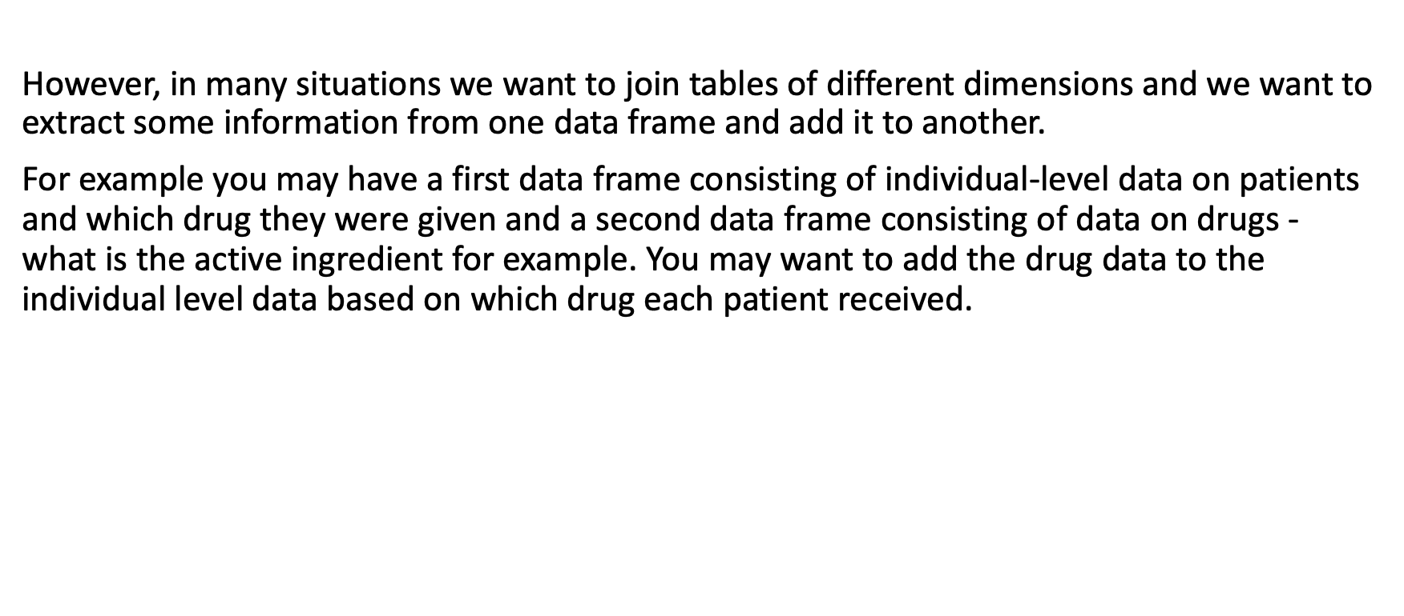
Working with data - handling data
However, in many situations we want to join tables of different dimensions and we want to extract some information from one data frame and add it to another.
For example you may have a first data frame consisting of individual-level data on patients and which drug they were given and a second data frame consisting of data on drugs - what is the active ingredient for example. You may want to add the drug data to the individual level data based on which drug each patient received.

Slide 77
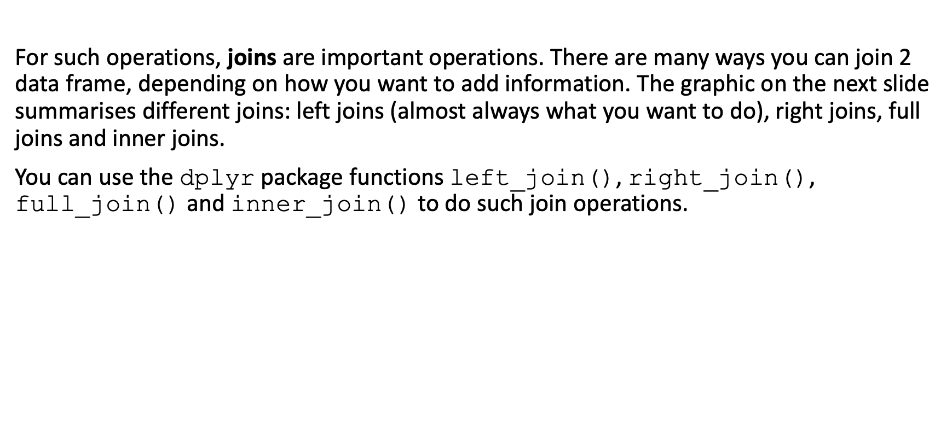
Working with data - handling data
For such operations, joins are important operations. There are many ways you can join 2 data frame, depending on how you want to add information. The graphic on the next slide summarises different joins: left joins (almost always what you want to do), right joins, full joins and inner joins.
You can use the dplyr package functions left_join(), right_join(), full_join() and inner_join() to do such join operations.

Slide 78
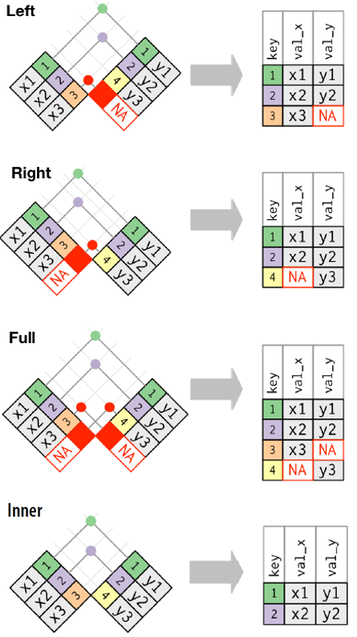
Working with data - handling data
Wickham, H. & Grolemund G., R for Data Science, O’Reilly, 2016

Slide 79
Working with data - handling data
# Patient-level data pDat<-data.frame( name=c("Marc","Ulemu","Clemens","Brigitte"), age=c(37,48,46,38), drug=c("Lariam","Lariam","Malarone","none") )

Slide 80
Working with data - handling data
head(pDat) ## name age drug ## 1 Marc 37 Lariam ## 2 Ulemu 48 Lariam ## 3 Clemens 46 Malarone ## 4 Brigitte 38 none

Slide 81
Working with data - handling data
# Drug-level data dDat<-data.frame( commonName=c("Acticlate","Aralen","Jasoprim","Lariam","Malarone","Malirid","Monodox"), ingredient=c("Doxycycline","Chloroquine","Primaquine","Mefloquine","Atavaquone/Proguanil","Primaquine","Doxycyline") )

Slide 82
Working with data - handling data
head(dDat) ## commonName ingredient ## 1 Acticlate Doxycycline ## 2 Aralen Chloroquine ## 3 Jasoprim Primaquine ## 4 Lariam Mefloquine ## 5 Malarone Atavaquone/Proguanil ## 6 Malirid Primaquine

Slide 83
Working with data - handling data
# Left join pDatWithDrug<-left_join(pDat,dDat,by=c("drug" = "commonName"))

Slide 84
Working with data - handling data
head(pDatWithDrug) ## name age drug ingredient ## 1 Marc 37 Lariam Mefloquine ## 2 Ulemu 48 Lariam Mefloquine ## 3 Clemens 46 Malarone Atavaquone/Proguanil ## 4 Brigitte 38 none <NA>

Slide 85
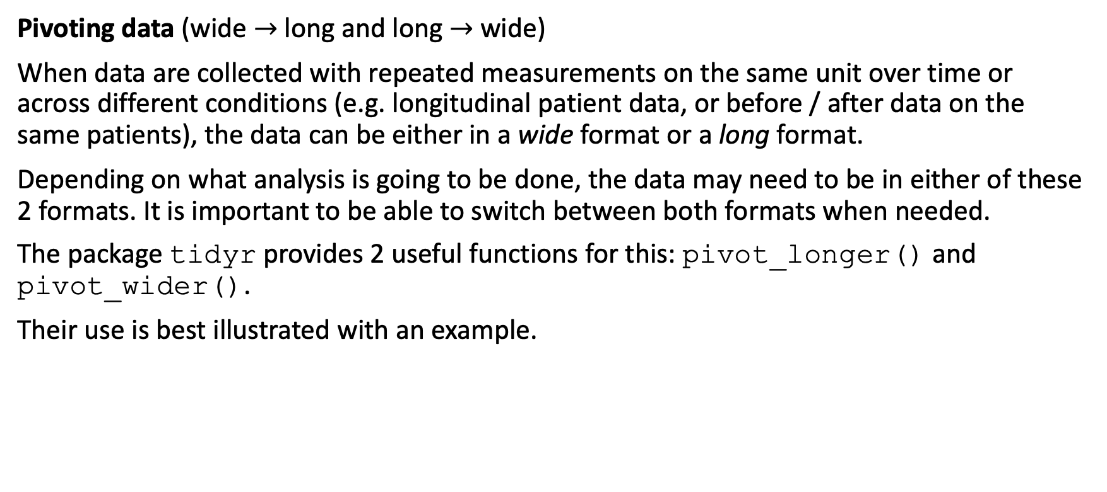
Working with data - handling data
Pivoting data (wide $→$ long and long $→$ wide)
When data are collected with repeated measurements on the same unit over time or across different conditions (e.g. longitudinal patient data, or before / after data on the same patients), the data can be either in a wide format or a long format.
Depending on what analysis is going to be done, the data may need to be in either of these 2 formats. It is important to be able to switch between both formats when needed.
The package tidyr provides 2 useful functions for this: pivot_longer() and pivot_wider().
Their use is best illustrated with an example.

Slide 86
Working with data - handling data
datWide <- read.table(header=TRUE, text=' subject sex control cond1 cond2 1 M 7.9 12.3 10.7 2 F 6.3 10.6 11.1 3 F 9.5 13.1 13.8 4 M 11.5 13.4 12.9 ') datWide$subject <- factor(datWide$subject)

Slide 87
Working with data - handling data
print(datWide) ## subject sex control cond1 cond2 ## 1 1 M 7.9 12.3 10.7 ## 2 2 F 6.3 10.6 11.1 ## 3 3 F 9.5 13.1 13.8 ## 4 4 M 11.5 13.4 12.9

Slide 88
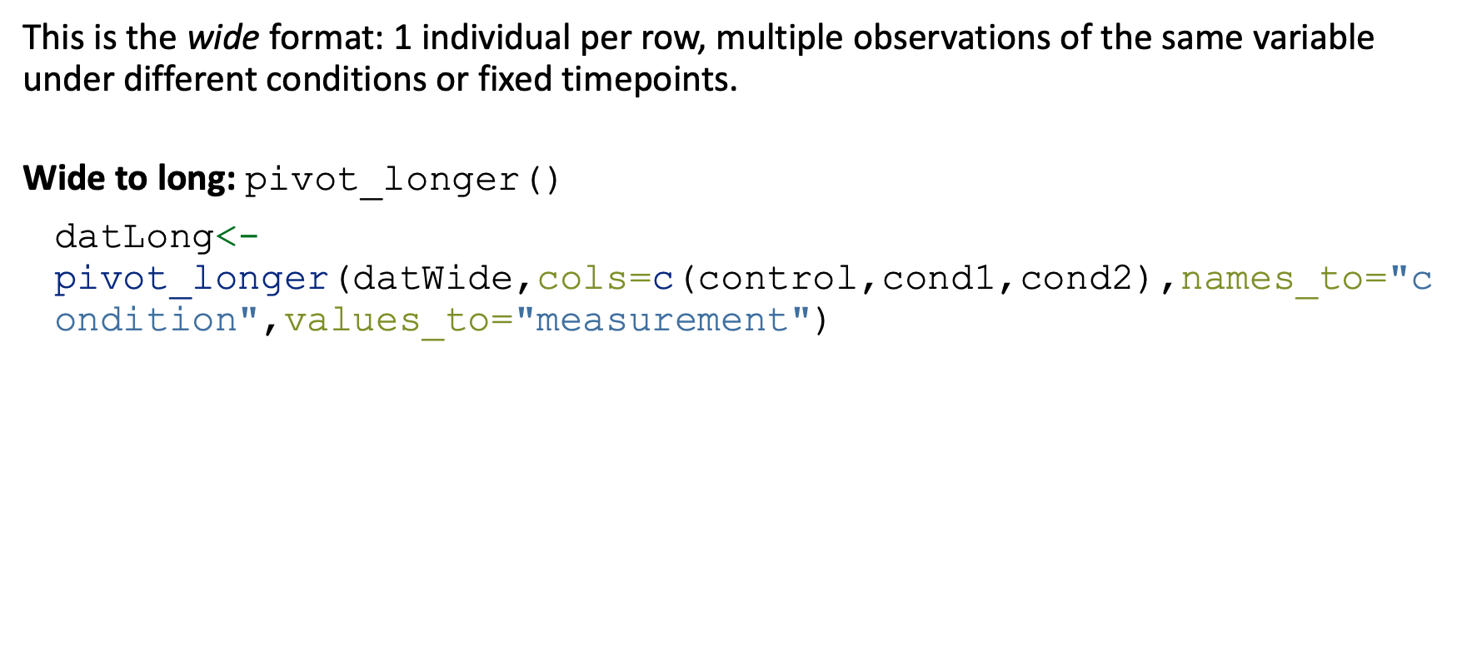
Working with data - handling data
This is the wide format: 1 individual per row, multiple observations of the same variable under different conditions or fixed timepoints.
Wide to long: pivot_longer()
datLong<-pivot_longer(datWide,cols=c(control,cond1,cond2),names_to="condition",values_to="measurement")

Slide 89
Working with data - handling data
print(datLong) ## # A tibble: 12 × 4 ## subject sex condition measurement ## <fct> <chr> <chr> <dbl> ## 1 1 M control 7.9 ## 2 1 M cond1 12.3 ## 3 1 M cond2 10.7 ## 4 2 F control 6.3 ## 5 2 F cond1 10.6 ## 6 2 F cond2 11.1 ## 7 3 F control 9.5 ## 8 3 F cond1 13.1 ## 9 3 F cond2 13.8 ## 10 4 M control 11.5 ## 11 4 M cond1 13.4 ## 12 4 M cond2 12.9

Slide 90
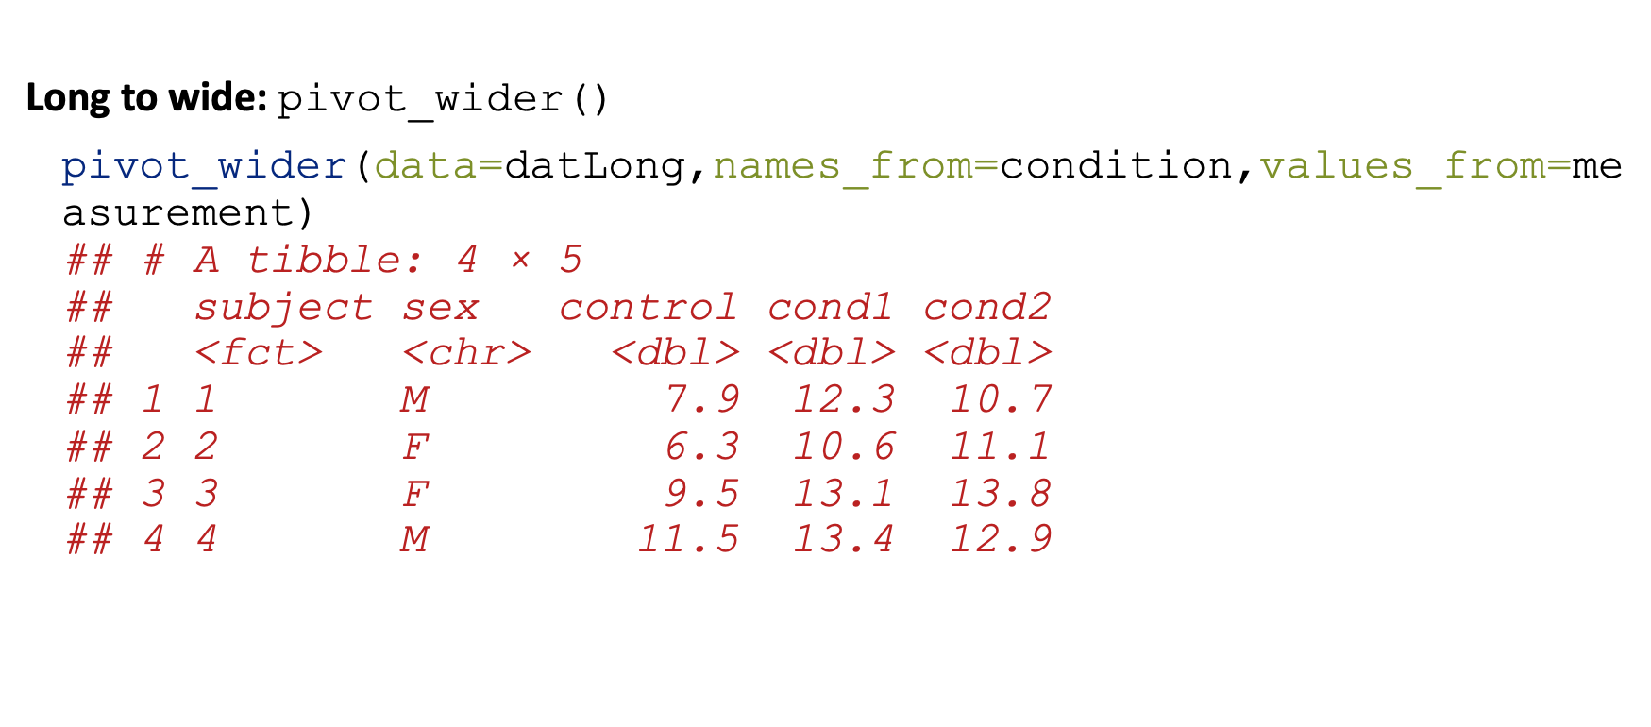
Working with data - handling data
Long to wide: pivot_wider()
pivot_wider(data=datLong,names_from=condition,values_from=measurement) ## # A tibble: 4 × 5 ## subject sex control cond1 cond2 ## <fct> <chr> <dbl> <dbl> <dbl> ## 1 1 M 7.9 12.3 10.7 ## 2 2 F 6.3 10.6 11.1 ## 3 3 F 9.5 13.1 13.8 ## 4 4 M 11.5 13.4 12.9

Slide 91
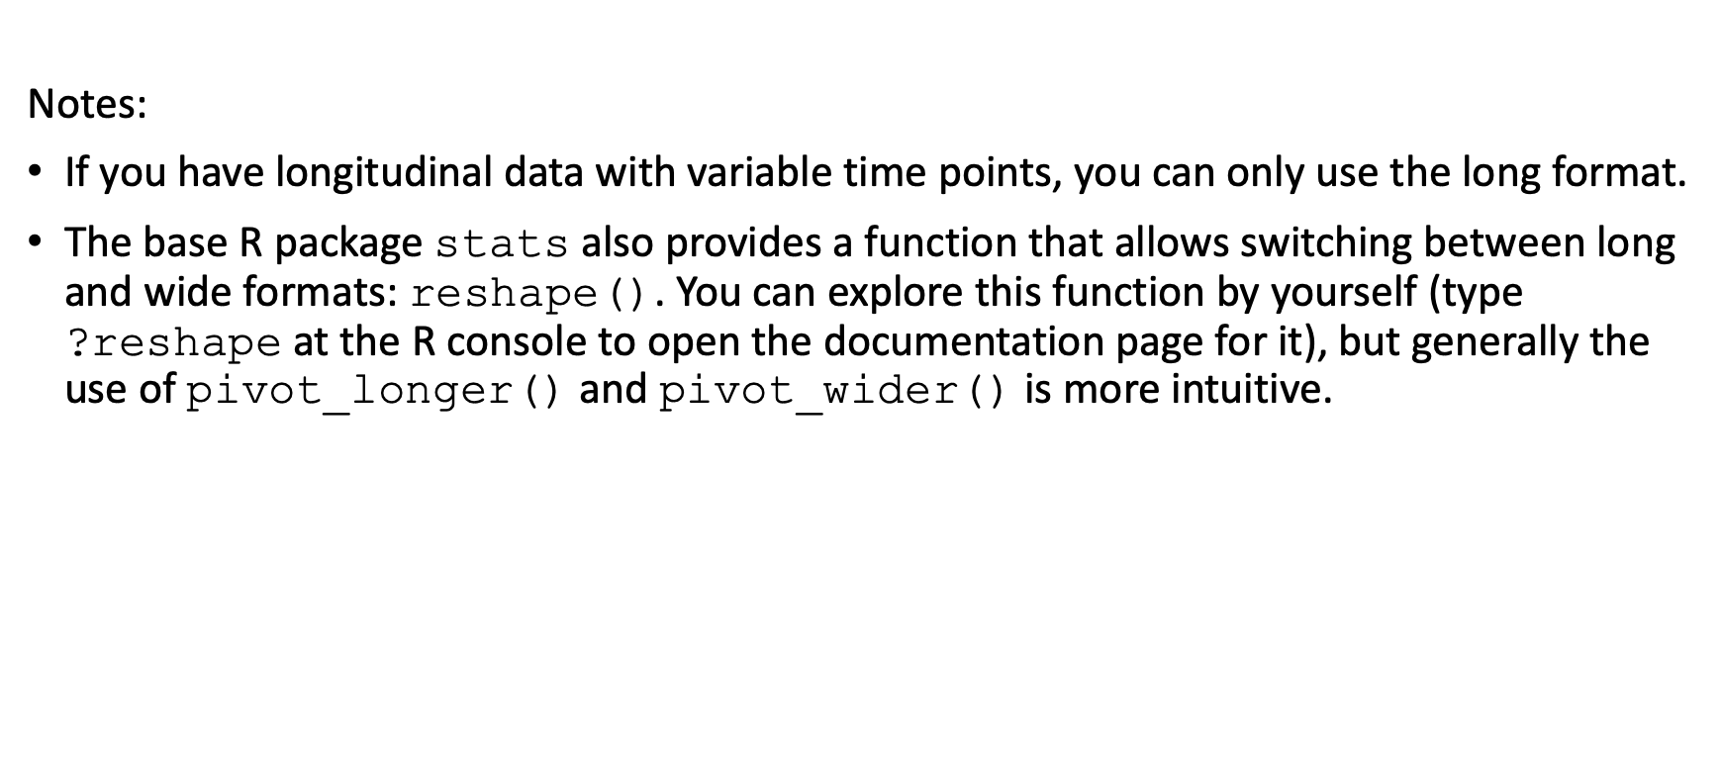
Working with data - handling data
Notes:
If you have longitudinal data with variable time points, you can only use the long format.
The base R package stats also provides a function that allows switching between long and wide formats: reshape(). You can explore this function by yourself (type ?reshape at the R console to open the documentation page for it), but generally the use of pivot_longer() and pivot_wider() is more intuitive.

Slide 92
Working with data - handling data
Sometimes packages compete which other.
For example, a filter() function can be found in at least these 3 packages:
stats
dplyr
mice
Likewise, a select() function can be found in at least these 2 packages:
MASS
dplyr
To avoid confusion and mistakes, it is often better to clarify which package you refer to. You do this by pre-pending the package name in front of the function name:
dplyr::filter()
dplyr::select()
mice::filter()

Slide 93
R programming / coding

Slide 94
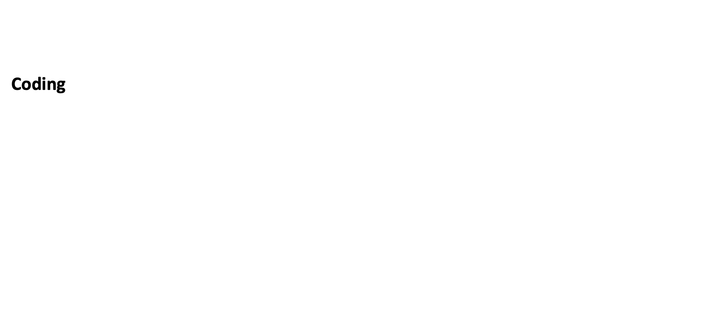
Coding
Coding

Slide 95
Coding - R functions
When you need to do a given set of commands over and over again, it may be more efficient to group them in an R function - it avoids you to write repetitive code.
To define a function you need to use the R function function(). Inside the brackets you then specify the input arguments to the function you define. The body of code for the function follows in curly brackets after the call to function.
On the next slide is an example where we define a new function, summaryFunction(), that will compute the mean and standard deviation of a specific variable in a data frame and returns this as a list of length 2.

Slide 96
Coding - R functions
summaryFunction<-function(dat,var){ # dat = a data frame # var = a character string indicating the name of the variable in the dat data frame that is to be summarised m<-mean(dat[,var]) s<-sd(dat[,var]) return(list(mean=m,sd=s)) }

Slide 97
Coding - R functions
summaryFunction(dat=iris,var="Sepal.Width") ## $mean ## [1] 3.057333 ## ## $sd ## [1] 0.4358663

Slide 98
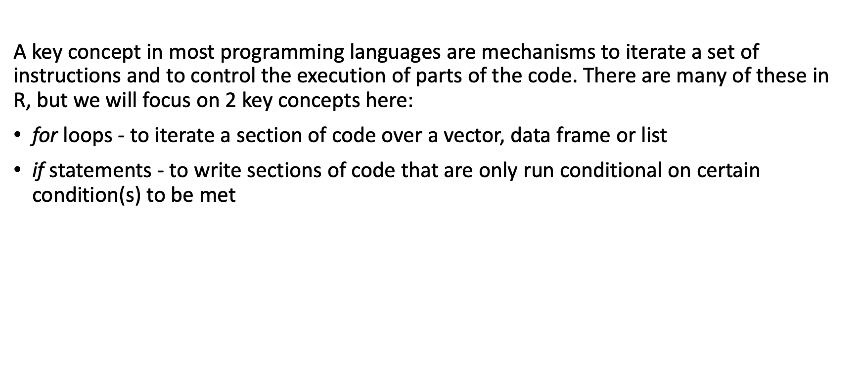
Coding - for loops, if statements
A key concept in most programming languages are mechanisms to iterate a set of instructions and to control the execution of parts of the code. There are many of these in R, but we will focus on 2 key concepts here:
for loops - to iterate a section of code over a vector, data frame or list
if statements - to write sections of code that are only run conditional on certain condition(s) to be met

Slide 99
Coding - for loops, if statements
# create an empty vector of the desired size flowerSize<-rep(NA,nrow(iris)) # iterate over all rows of the iris data frame for(i in 1:nrow(iris)){ flowerSize[i]<-iris$Petal.Length[i]+iris$Petal.Width[i]+iris$Sepal.Length[i]+iris$Sepal.Width[i] } irisNew4<-cbind(iris,flowerSize)

Slide 100
Coding - for loops, if statements
head(irisNew4) ## Sepal.Length Sepal.Width Petal.Length Petal.Width Species flowerSize ## 1 5.1 3.5 1.4 0.2 setosa 10.2 ## 2 4.9 3.0 1.4 0.2 setosa 9.5 ## 3 4.7 3.2 1.3 0.2 setosa 9.4 ## 4 4.6 3.1 1.5 0.2 setosa 9.4 ## 5 5.0 3.6 1.4 0.2 setosa 10.2 ## 6 5.4 3.9 1.7 0.4 setosa 11.4

Slide 101
Coding - for loops, if statements
for loops are slow in R. Whenever possible, attempt to vectorise your operations.
# what we've just done forLoop<-function(){ flowerSize<-rep(NA,nrow(iris)) for(i in 1:nrow(iris)){ flowerSize[i]<-iris$Petal.Length[i]+iris$Petal.Width[i]+iris$Sepal.Length[i]+iris$Sepal.Width[i] } }

Slide 102
Coding - for loops, if statements
# same operation but vectorised vectorOperation<-function(){ flowerSize<-iris$Petal.Length+iris$Petal.Width+iris$Sepal.Length+iris$Sepal.Width }

Slide 103
Coding - for loops, if statements
system.time(forLoop()) ## user system elapsed ## 0.003 0.000 0.003 system.time(vectorOperation()) ## user system elapsed ## 0 0 0

Slide 104
Parameter estimation / summary statistics (primer)

Slide 105
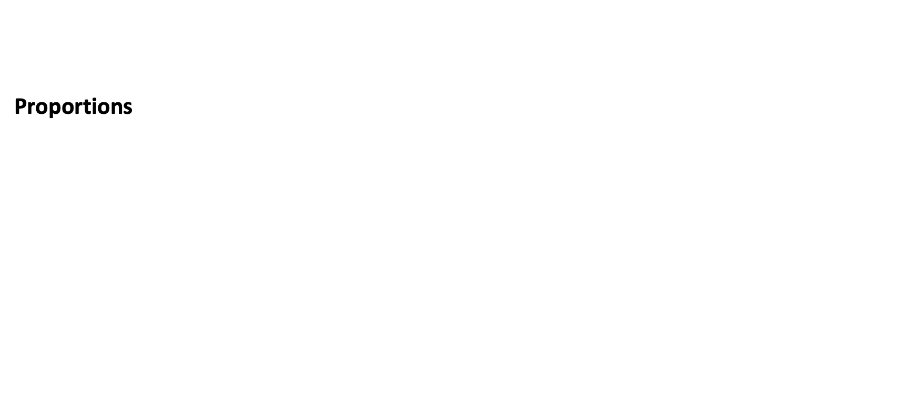
Parameter estimation / summary statistics
Proportions

Slide 106
Parameter estimation / summary statistics
The function binom.test() allows you to easily compute proportion estimates and exact binomial 95% confidence intervals:
propEst<-binom.test(x=sum(dat$Species=="setosa"),n=nrow(dat)) propEst$estimate ## probability of success ## 0.3333333 propEst$conf.int ## [1] 0.2585564 0.4148430 ## attr(,"conf.level") ## [1] 0.95

Slide 107
Parameter estimation / summary statistics
Formatting this nicely and expressing it as percentages:
propNice<-paste(sep="", format(nsmall=1,round(digits=1,100*propEst$estimate)), "% (", format(nsmall=1,round(digits=1,100*propEst$conf.int[1])), "%, ", format(nsmall=1,round(digits=1,100*propEst$conf.int[2])), "%)") cat(propNice,file="") ## 33.3% (25.9%, 41.5%)

Slide 108
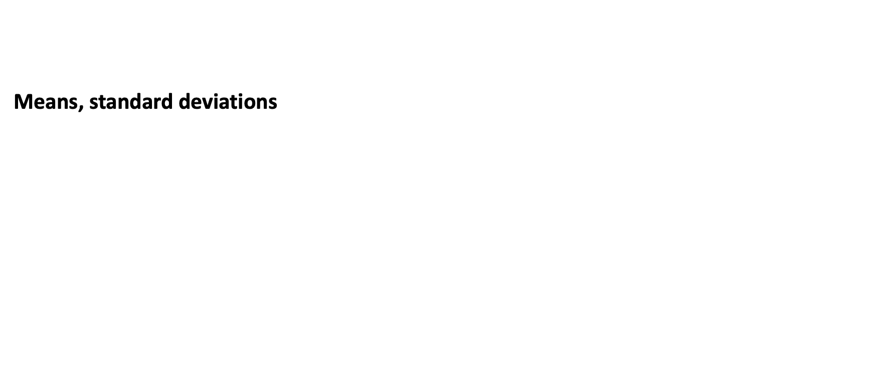
Parameter estimation / summary statistics
Means, standard deviations

Slide 109
Parameter estimation / summary statistics
To compute an arithmetic mean, the R function mean() can be used and for standard deviations the function sd() is used.
mu<-mean(dat$Petal.Length,na.rm=TRUE) sigma<-sd(dat$Petal.Length,na.rm=TRUE) sigma2<-sigma^2 # same as sigma2<-var(dat$Petal.Length,na.rm=TRUE) n<-sum(!is.na(dat$Petal.Length)) ci<-c( mu - qnorm(0.975)*sigma/sqrt(n), mu + qnorm(0.975)*sigma/sqrt(n) )

Slide 110
Parameter estimation / summary statistics
print(mu) ## [1] 3.758 print(sigma) ## [1] 1.765298 print(sigma^2) ## [1] 3.116278 print(ci) ## [1] 3.475499 4.040501

Slide 111
Parameter estimation / summary statistics
To compute a median, the function median() is used and for IQRs, use quantile(). You can also use the function iqr() for the latter but this returns the width of the IQR.
me<-median(dat$Petal.Length,na.rm=TRUE) iqr<-quantile(dat$Petal.Length,probs=c(0.25,0.75),na.rm=TRUE)

Slide 112
Parameter estimation / summary statistics
print(me) ## [1] 4.35 print(iqr) ## 25% 75% ## 1.6 5.1

Slide 113

Parameter estimation / summary statistics
Grouping and summarising

Slide 114
Parameter estimation / summary statistics
Often it is easiest to summarise a dataset, when you group observations. The R functions group_by() and summarise() are useful here.
dat %>% group_by(Species) %>% summarise( mean=mean(Petal.Length), median=median(Petal.Length), sd=sd(Petal.Length), q25=quantile(Petal.Length,probs=0.25), q75=quantile(Petal.Length,probs=0.75) ,.groups="drop") ## # A tibble: 3 × 6 ## Species mean median sd q25 q75 ## <chr> <dbl> <dbl> <dbl> <dbl> <dbl> ## 1 setosa 1.46 1.5 0.174 1.4 1.58 ## 2 versicolor 4.26 4.35 0.470 4 4.6 ## 3 virginica 5.55 5.55 0.552 5.1 5.88

Slide 115
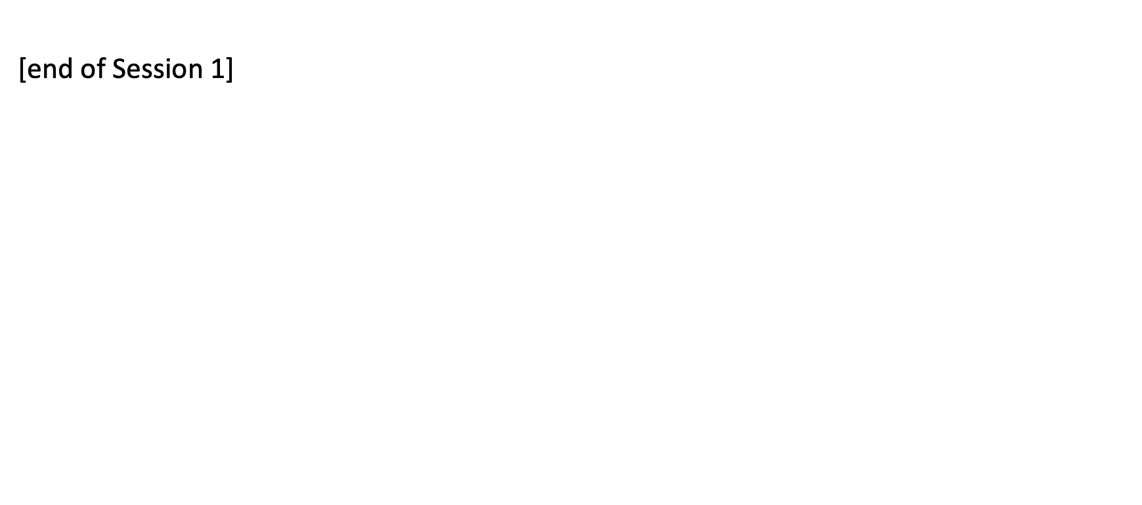
[end of Session 1]

